Slide 1
What’s New in SAFe® 5.0
Your Operating System for Business Agility

Slide 2


“
Those who master large-scale software delivery will define the economic landscape of the 21st century.
—Mik Kersten

Slide 3
Five technological revolutions
Installation Period
Turning Point
Deployment Period
1771
1793-1801
Industrial
Revolution
Canal Maria (UK)
Great British Leap
1829
1848-1850
Age of Steam
& Railways
Railway Mania (UK)
The Victoria Boom
1875
1890-1895
Age of Steel &
Heavy Engineering
London funded global market
infrastructure build-up
Belle Epoque (Europe)
Progressive Era (USA)
1908
1929-1943
Age of Oil &
Mass Production
The Roaring Twenties
Post-War Golden Age
1971
2000-?
Age of Software
& Digital
Dotcom and internet mania;
Global finance and housing bubbles
?
Adapted from Technological Revolutions and Financial Capital, Carlota Perez

Slide 4

Are we at the turning point?
“BMW Group’s CEO expects that in their future more than half of its R&D staff will be software developers.” —Mik Kersten, Project to Product
Amazon and Whole Foods Merger to Introduce Cross-Platform Selling and Lower Prices (Forbes, August 2017)
The market cap of Tesla ($43B market cap, $21B revenue) now exceeds the market cap of Ford ($36.2B market cap, $160B revenue) 8:1 value ratio
(September 2019)
Apple is now the biggest watchmaker in the world
(Investopedia 2019)
﻿
﻿

Slide 5
Competing in the Age of Software
“
The problem is not with our organizations realizing that they need to transform; the problem is that organizations are using managerial frameworks and infrastructure models from past revolutions to manage their businesses in this one.
—Mik Kersten

Slide 6


Rethinking the organization
“
The world is now changing at a rate at which the basic systems, structures, and cultures built over the past century cannot keep up with the demands being placed on them.
—John P. Kotter

Slide 7
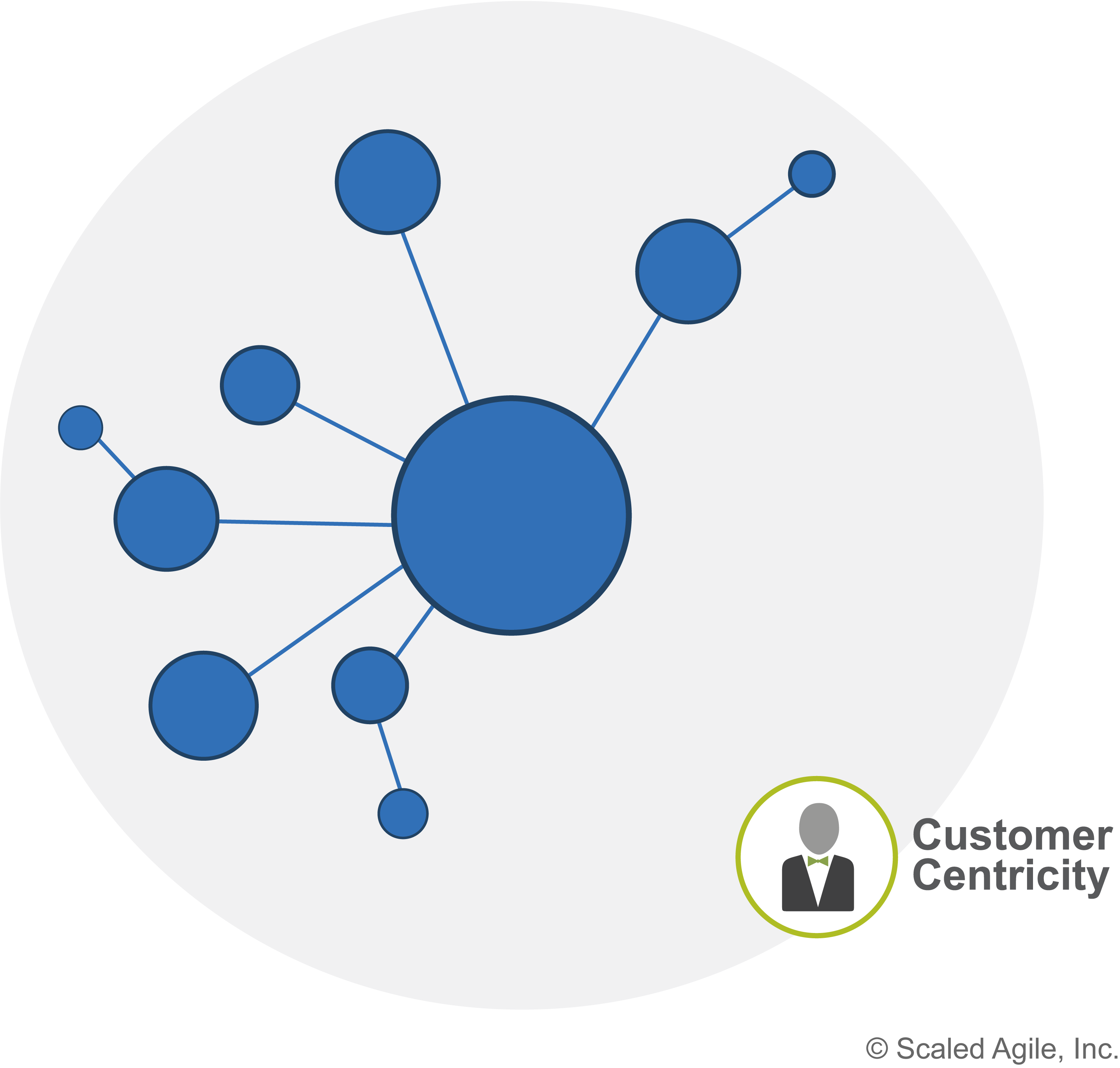
We started with a network

Slide 8

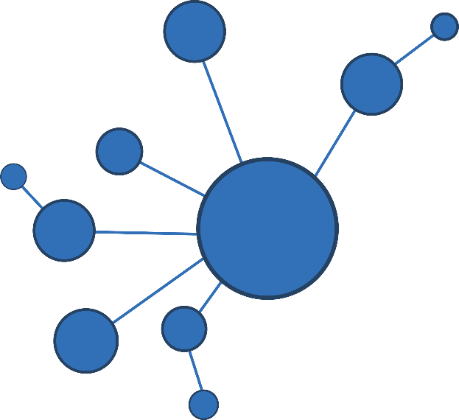

We add hierarchy for stability and execution
Speed of Innovation
Customer
Centricity

Slide 9
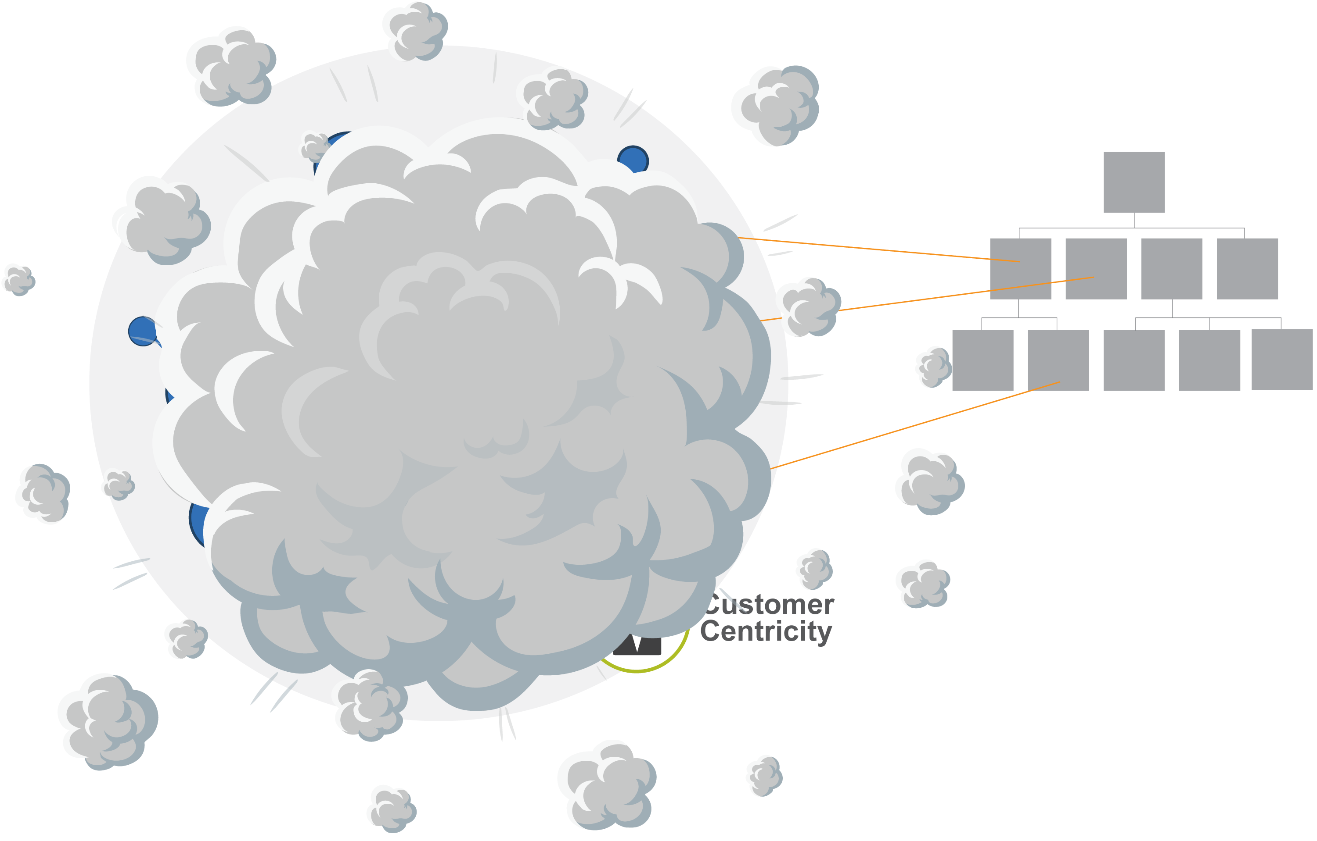
Guess what happens?

Slide 10
“
The solution is not to trash what we know and start over but instead to reintroduce a second system—one which would be familiar to most successful entrepreneurs.
You need a dual operating system.
—John P. Kotter

Slide 11

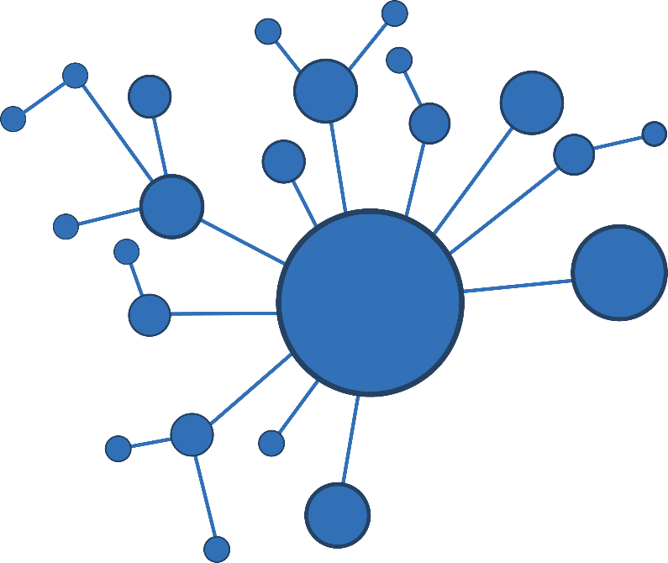

We need a dual operating system for business agility
Speed of Innovation
Customer
Centricity
Efficiency and stability

Slide 12
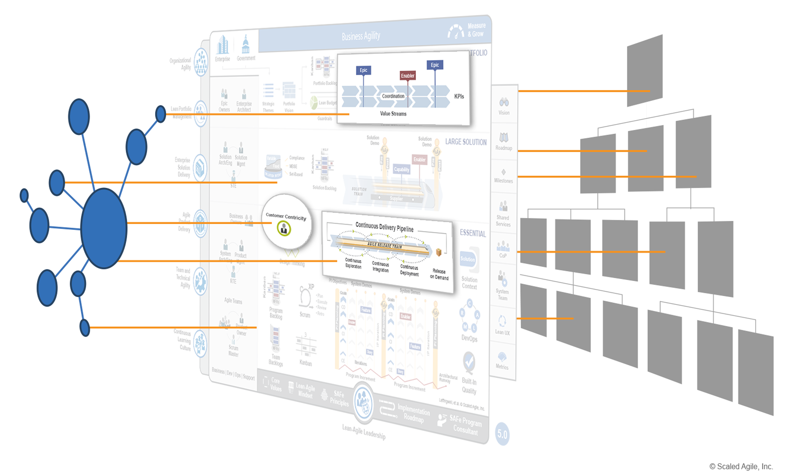
And we have just such an operating system at our fingertips
Value Stream Network
Functional hierarchy

Slide 13
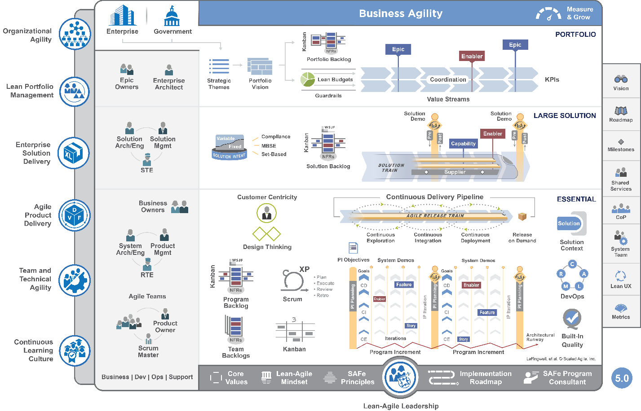
Introducing SAFe 5.0 the operating system for Business Agility
’
scaledagileframework.com

Slide 14
SAFe 5.0 brings the focus back to what it takes to bring great solutions to the marketplace.

Slide 15
Achieving a state of business agility means that the entire organization—not just development—is engaged in continually and proactively delivering innovative business solutions faster than the competition.

Slide 16
Business Agility requires technical agility and
a business-level commitment to product and value stream thinking.
And it requires that everyone involved in delivering business solutions use Lean and Agile practices.

Slide 17
Big Picture Highlights

Slide 18
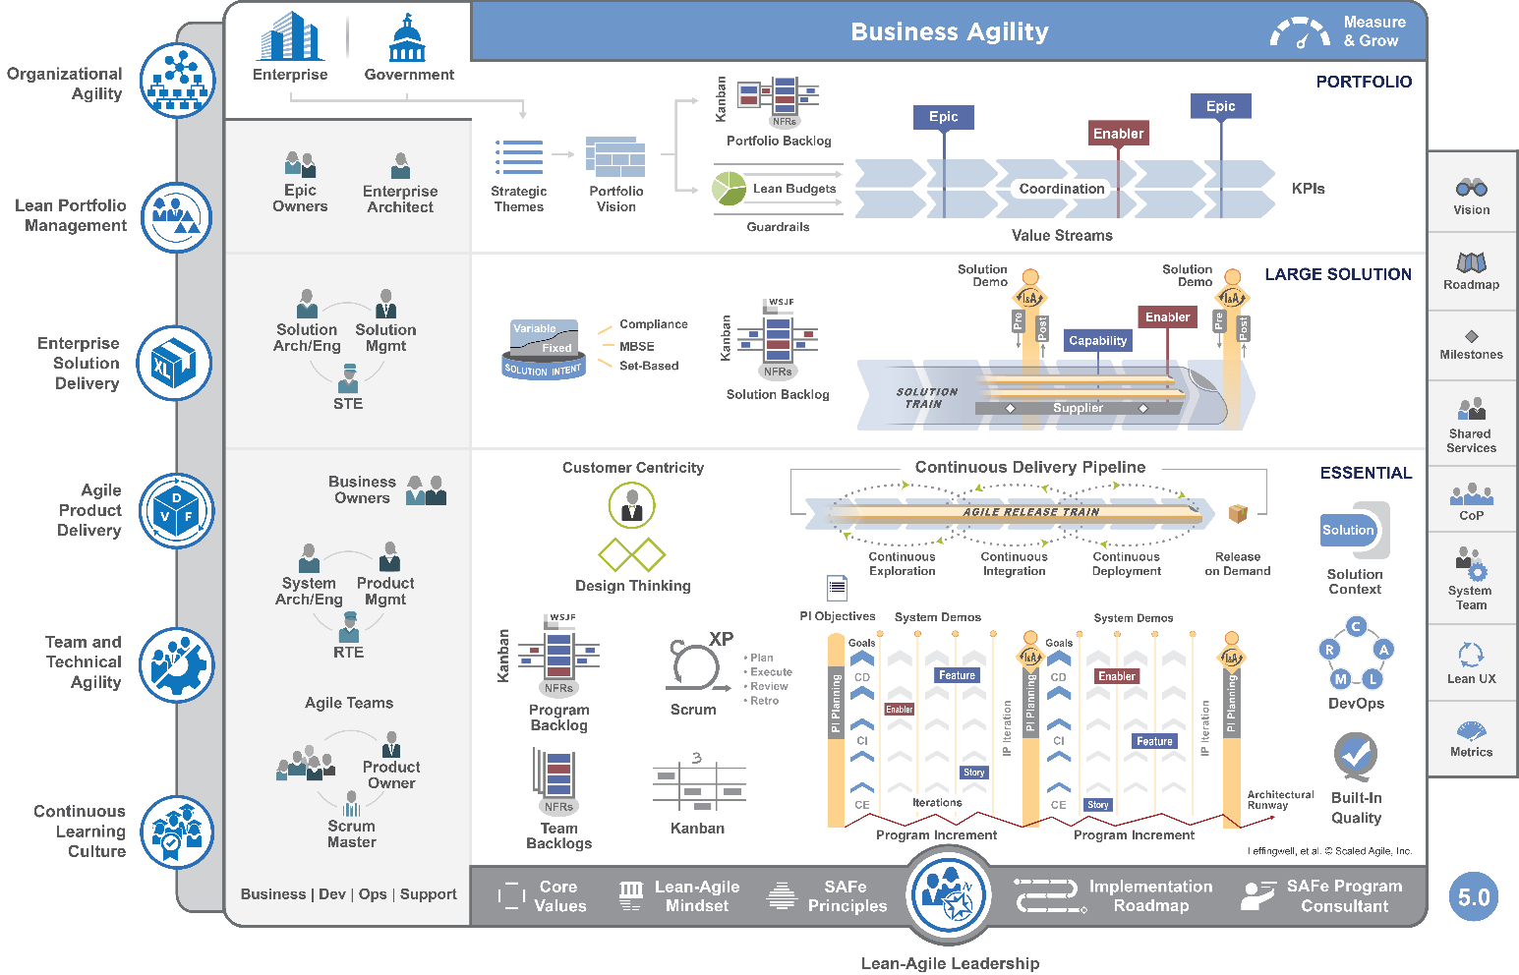
New focus on business agility

Slide 19
Competencies and the spanning palette

Slide 20
Two new core competencies

Slide 21
Renamed and expanded two competencies
Previously ‘Business Solutions and Lean Systems Engineering’
Previously ‘DevOps and Release on Demand’

Slide 22
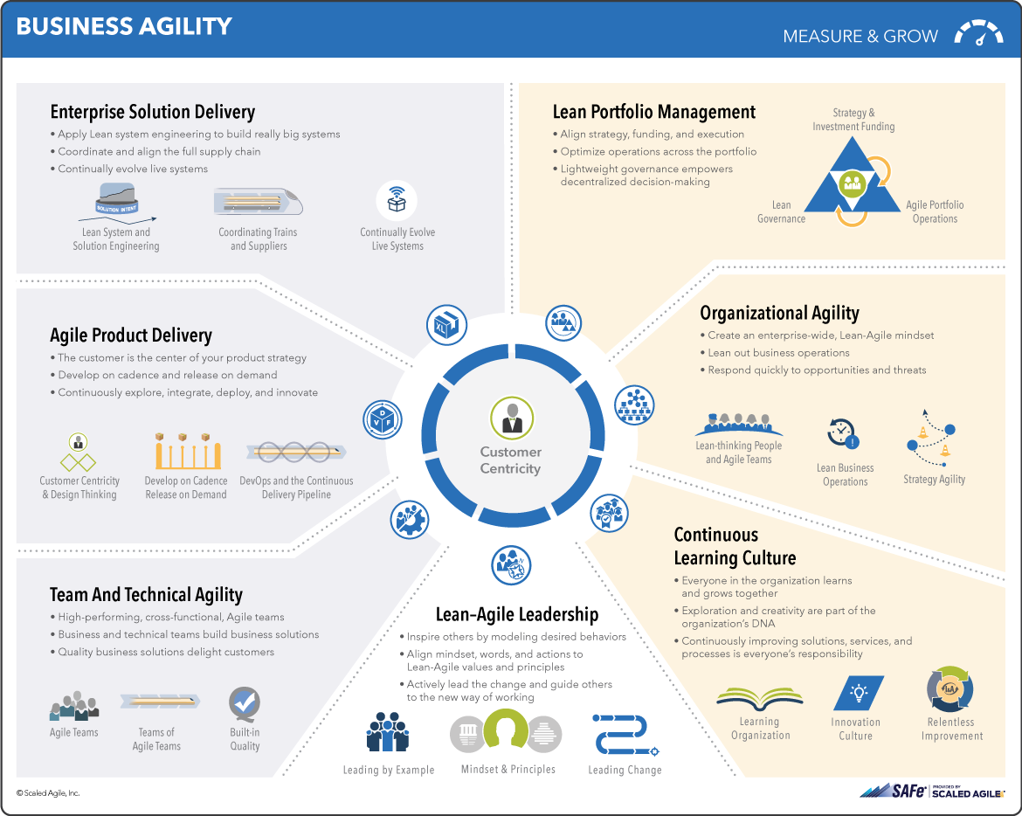
New SAFe Overview tab

Slide 23
The Seven Competencies of Business Agility

Slide 24
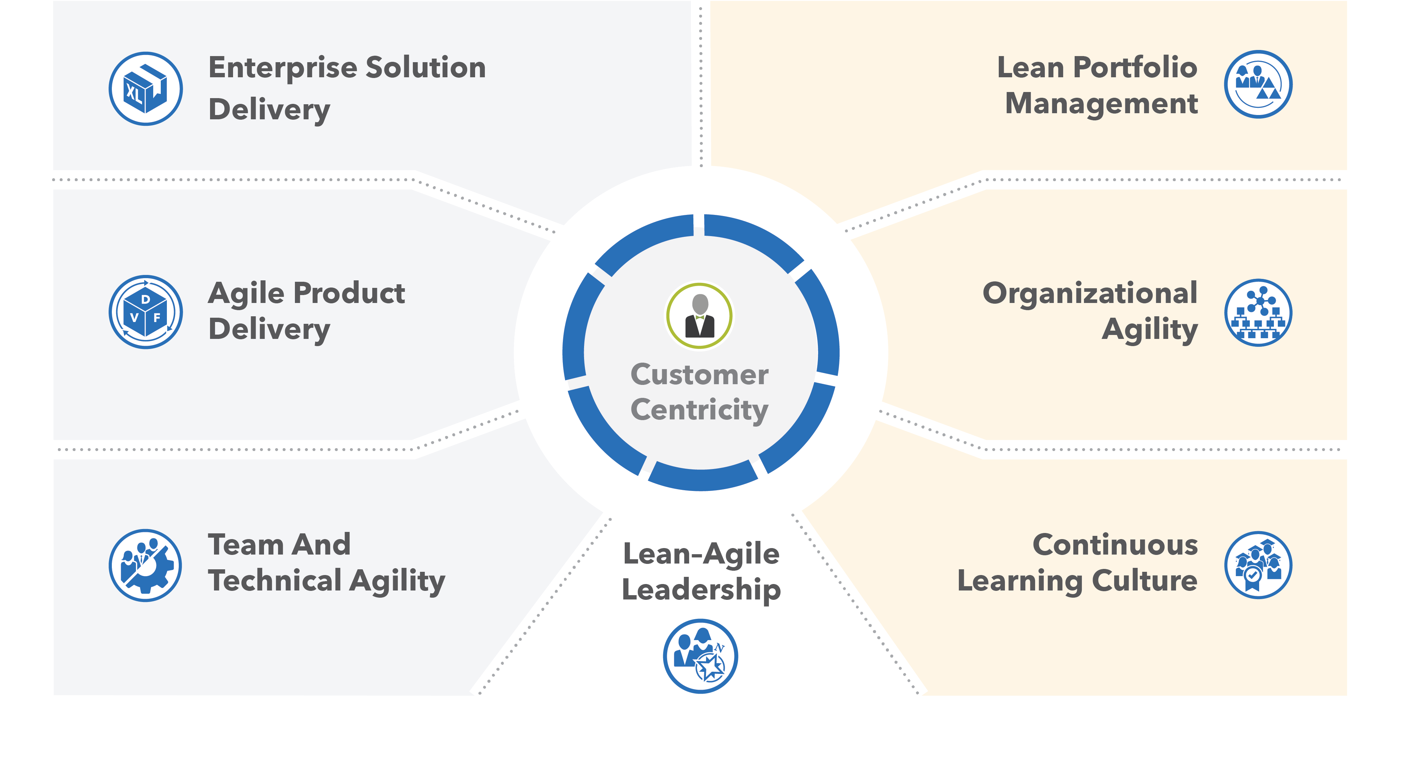
Seven Core Competencies of Business Agility

Slide 25

Why Team and Technical Agility?
Agile teams and teams of Agile teams create and support the business solutions that deliver value to the enterprise’s customers. Consequently, an organization’s ability to thrive in the digital age is entirely dependent on the ability of its teams to deliver solutions that reliably meet a customer’s needs.

Slide 26

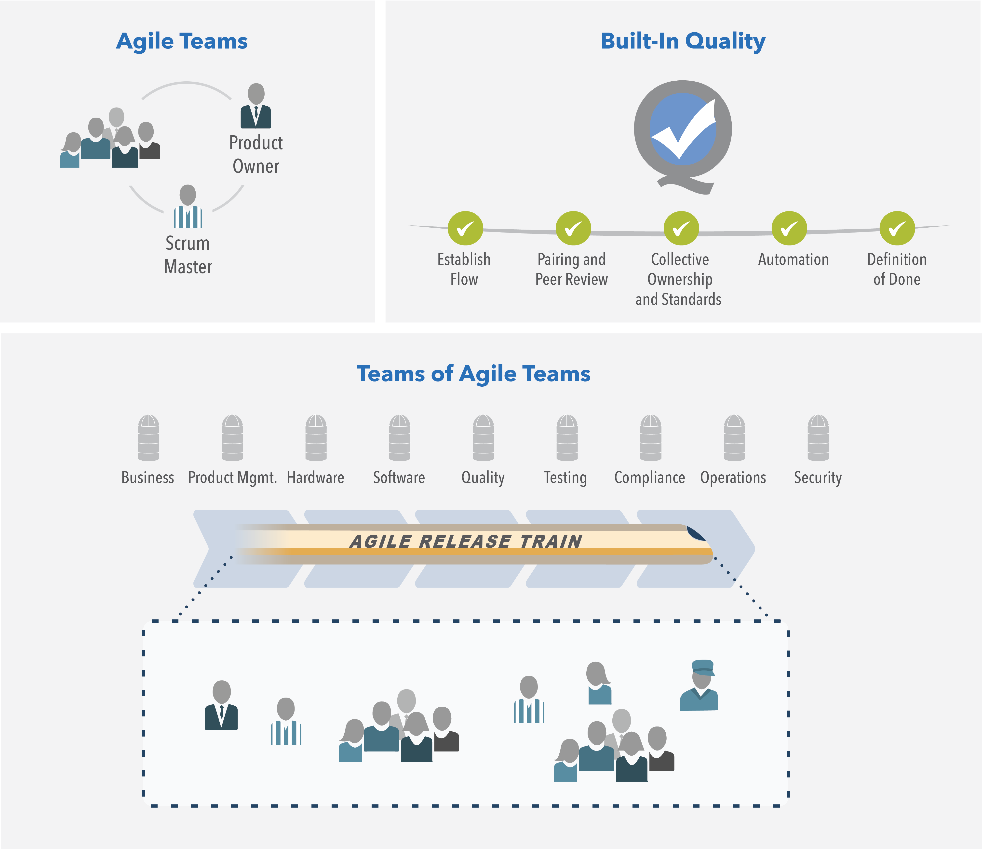

Team and Technical Agility
High-performing, cross-functional, Agile teams
Business and technical teams build business solutions
Quality business solutions delight customers

Slide 27
Essential SAFe combines program and team levels

Slide 28
SAFe for Business Teams

Slide 29
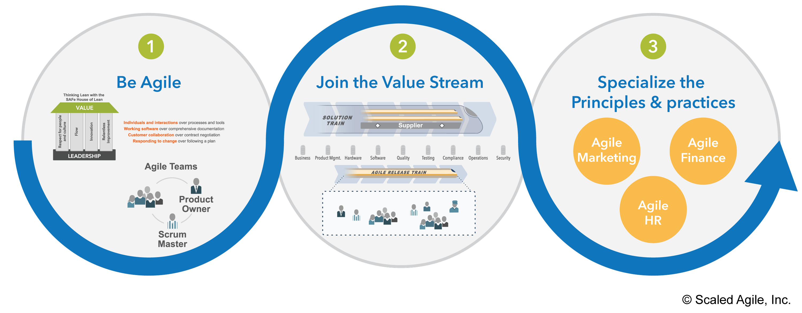
Agile Business Team maturity

Slide 30

Why Agile Product Delivery?
In order to achieve Business Agility, enterprises must rapidly increase their ability to deliver innovative products and services. To be sure that the enterprise is creating the right solutions for the right customers at the right time, they must balance their execution focus with a customer focus.

Slide 31

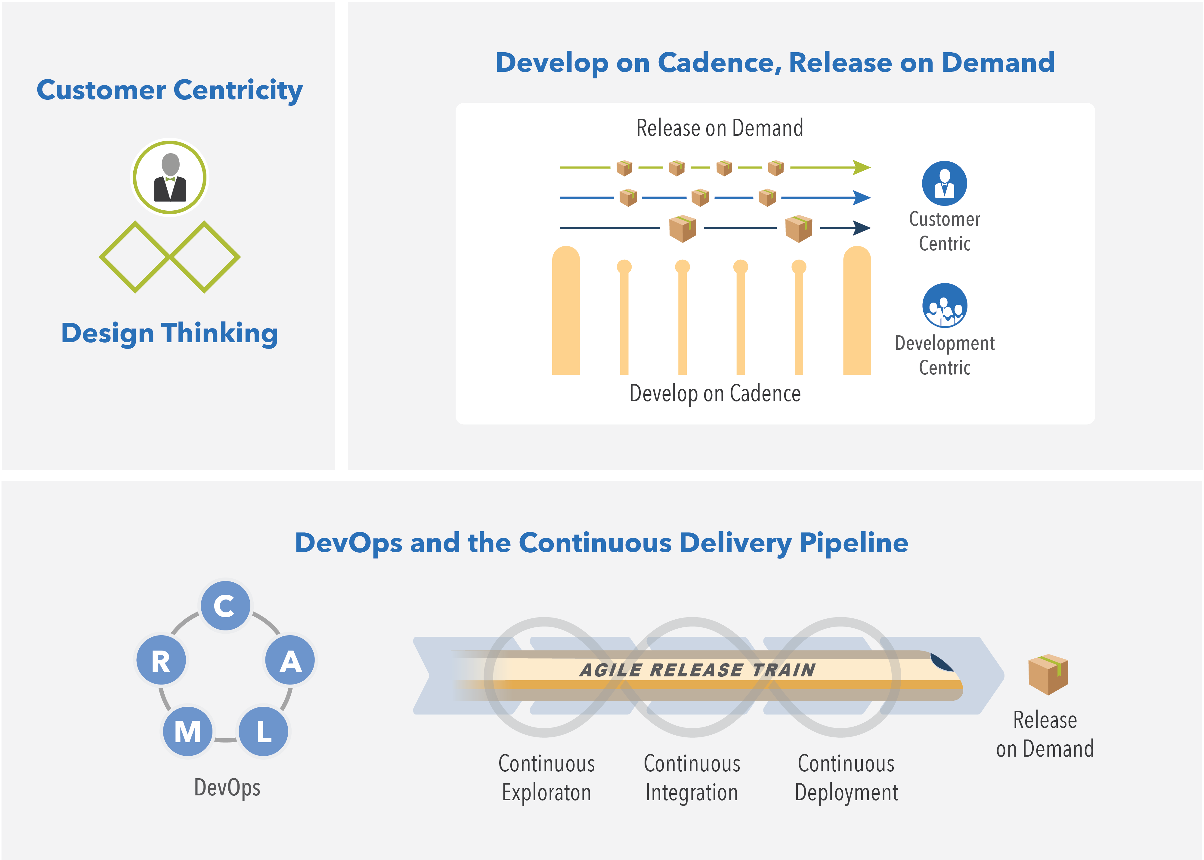
Agile Product Delivery
Customer-centric product strategy
Develop on cadence and release on demand
Continuously explore, integrate, deploy, and innovate

Slide 32
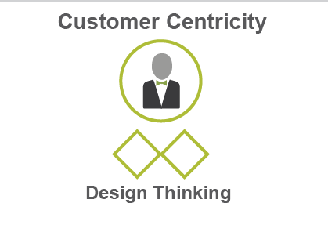
More focus on customer centricity and design thinking

Slide 33
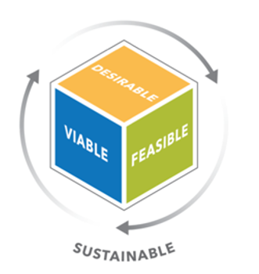
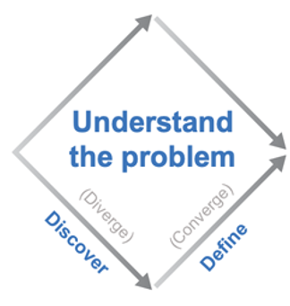
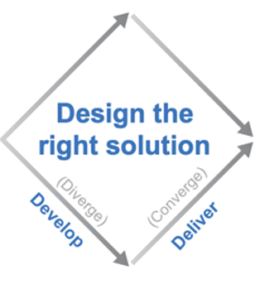
Design Thinking
A customer centric development process and the application of specific tools.
Problem Space Solution Space
Epics &
Features
Gemba Walks
Journey
Maps
Prototyping
Personas
Empathy maps
Story
Mapping
Clear understanding of target market and problems it’s facing.

Slide 34
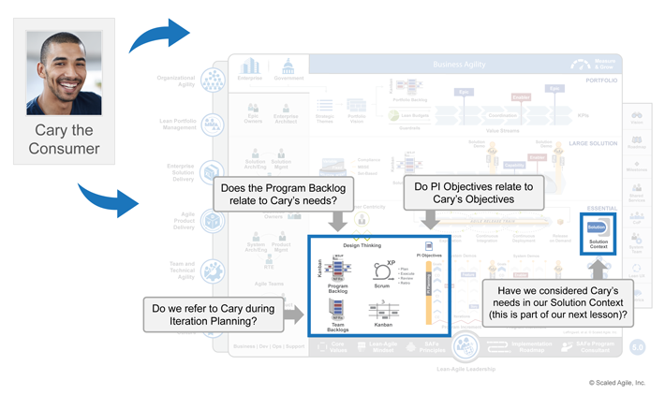
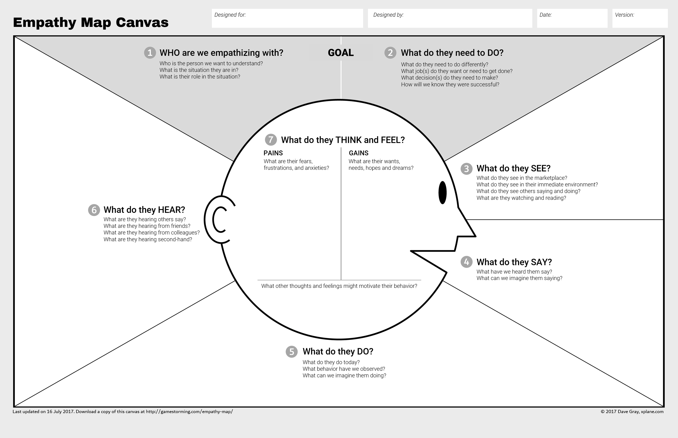
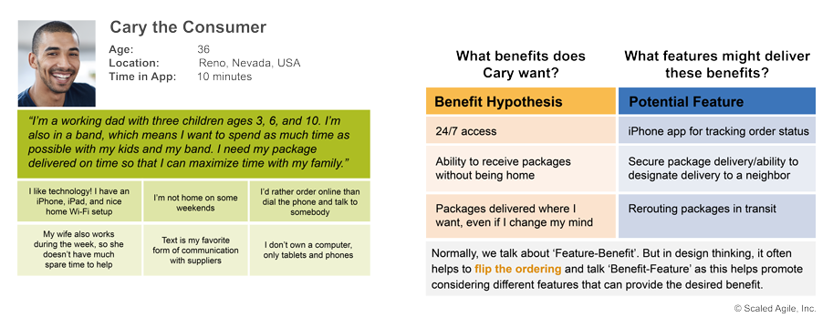
Personas and empathy maps
Personas: reinforce that products and solutions are created for people
Empathy Maps: use the customer’s perspective to inform solution development
Feature-Benefits Matrix: flipped to Benefits-Feature Matrix

Slide 35
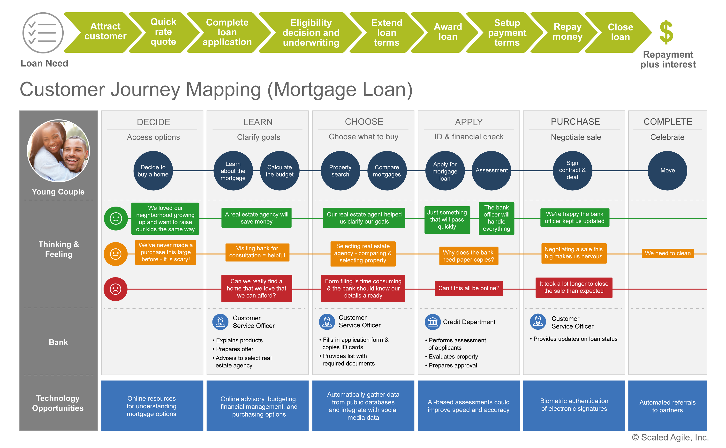

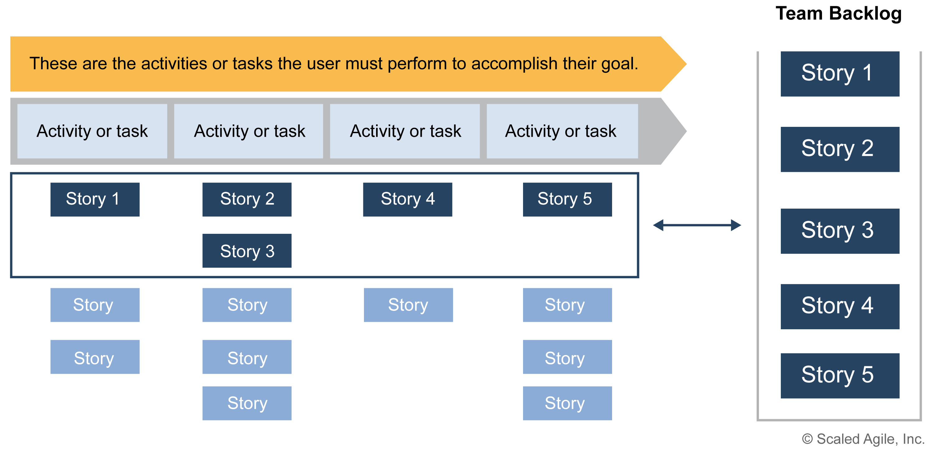
Customer journey maps, story maps, and prototyping
Prototypes: increase design Feedback
Journey Maps: design thinking tool for Operational Value Streams
Paper
Mid-fi
Hi-fi
Hardware
Story Maps: design the User Workflow

Slide 36
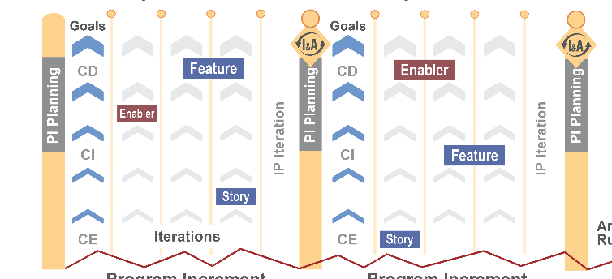
Continuous Delivery in Iterations

Slide 37
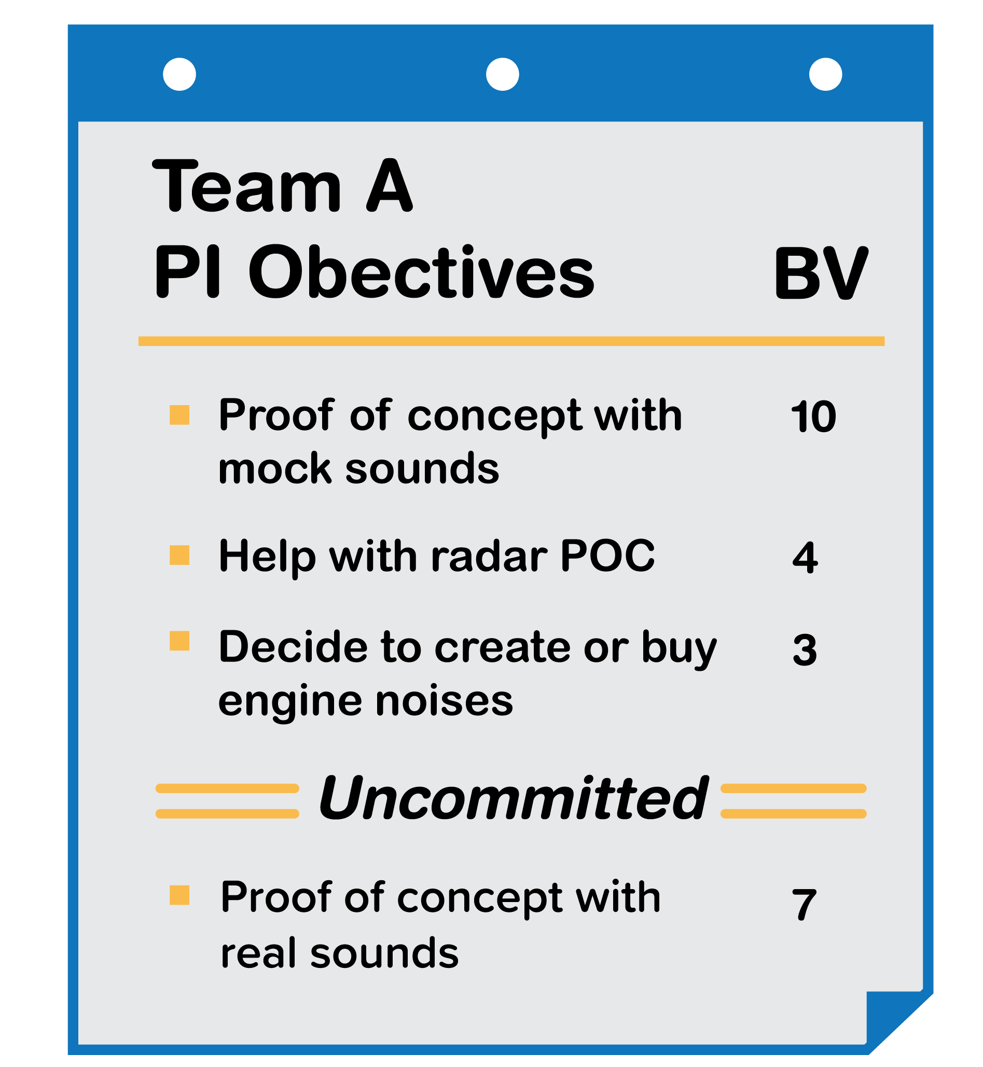
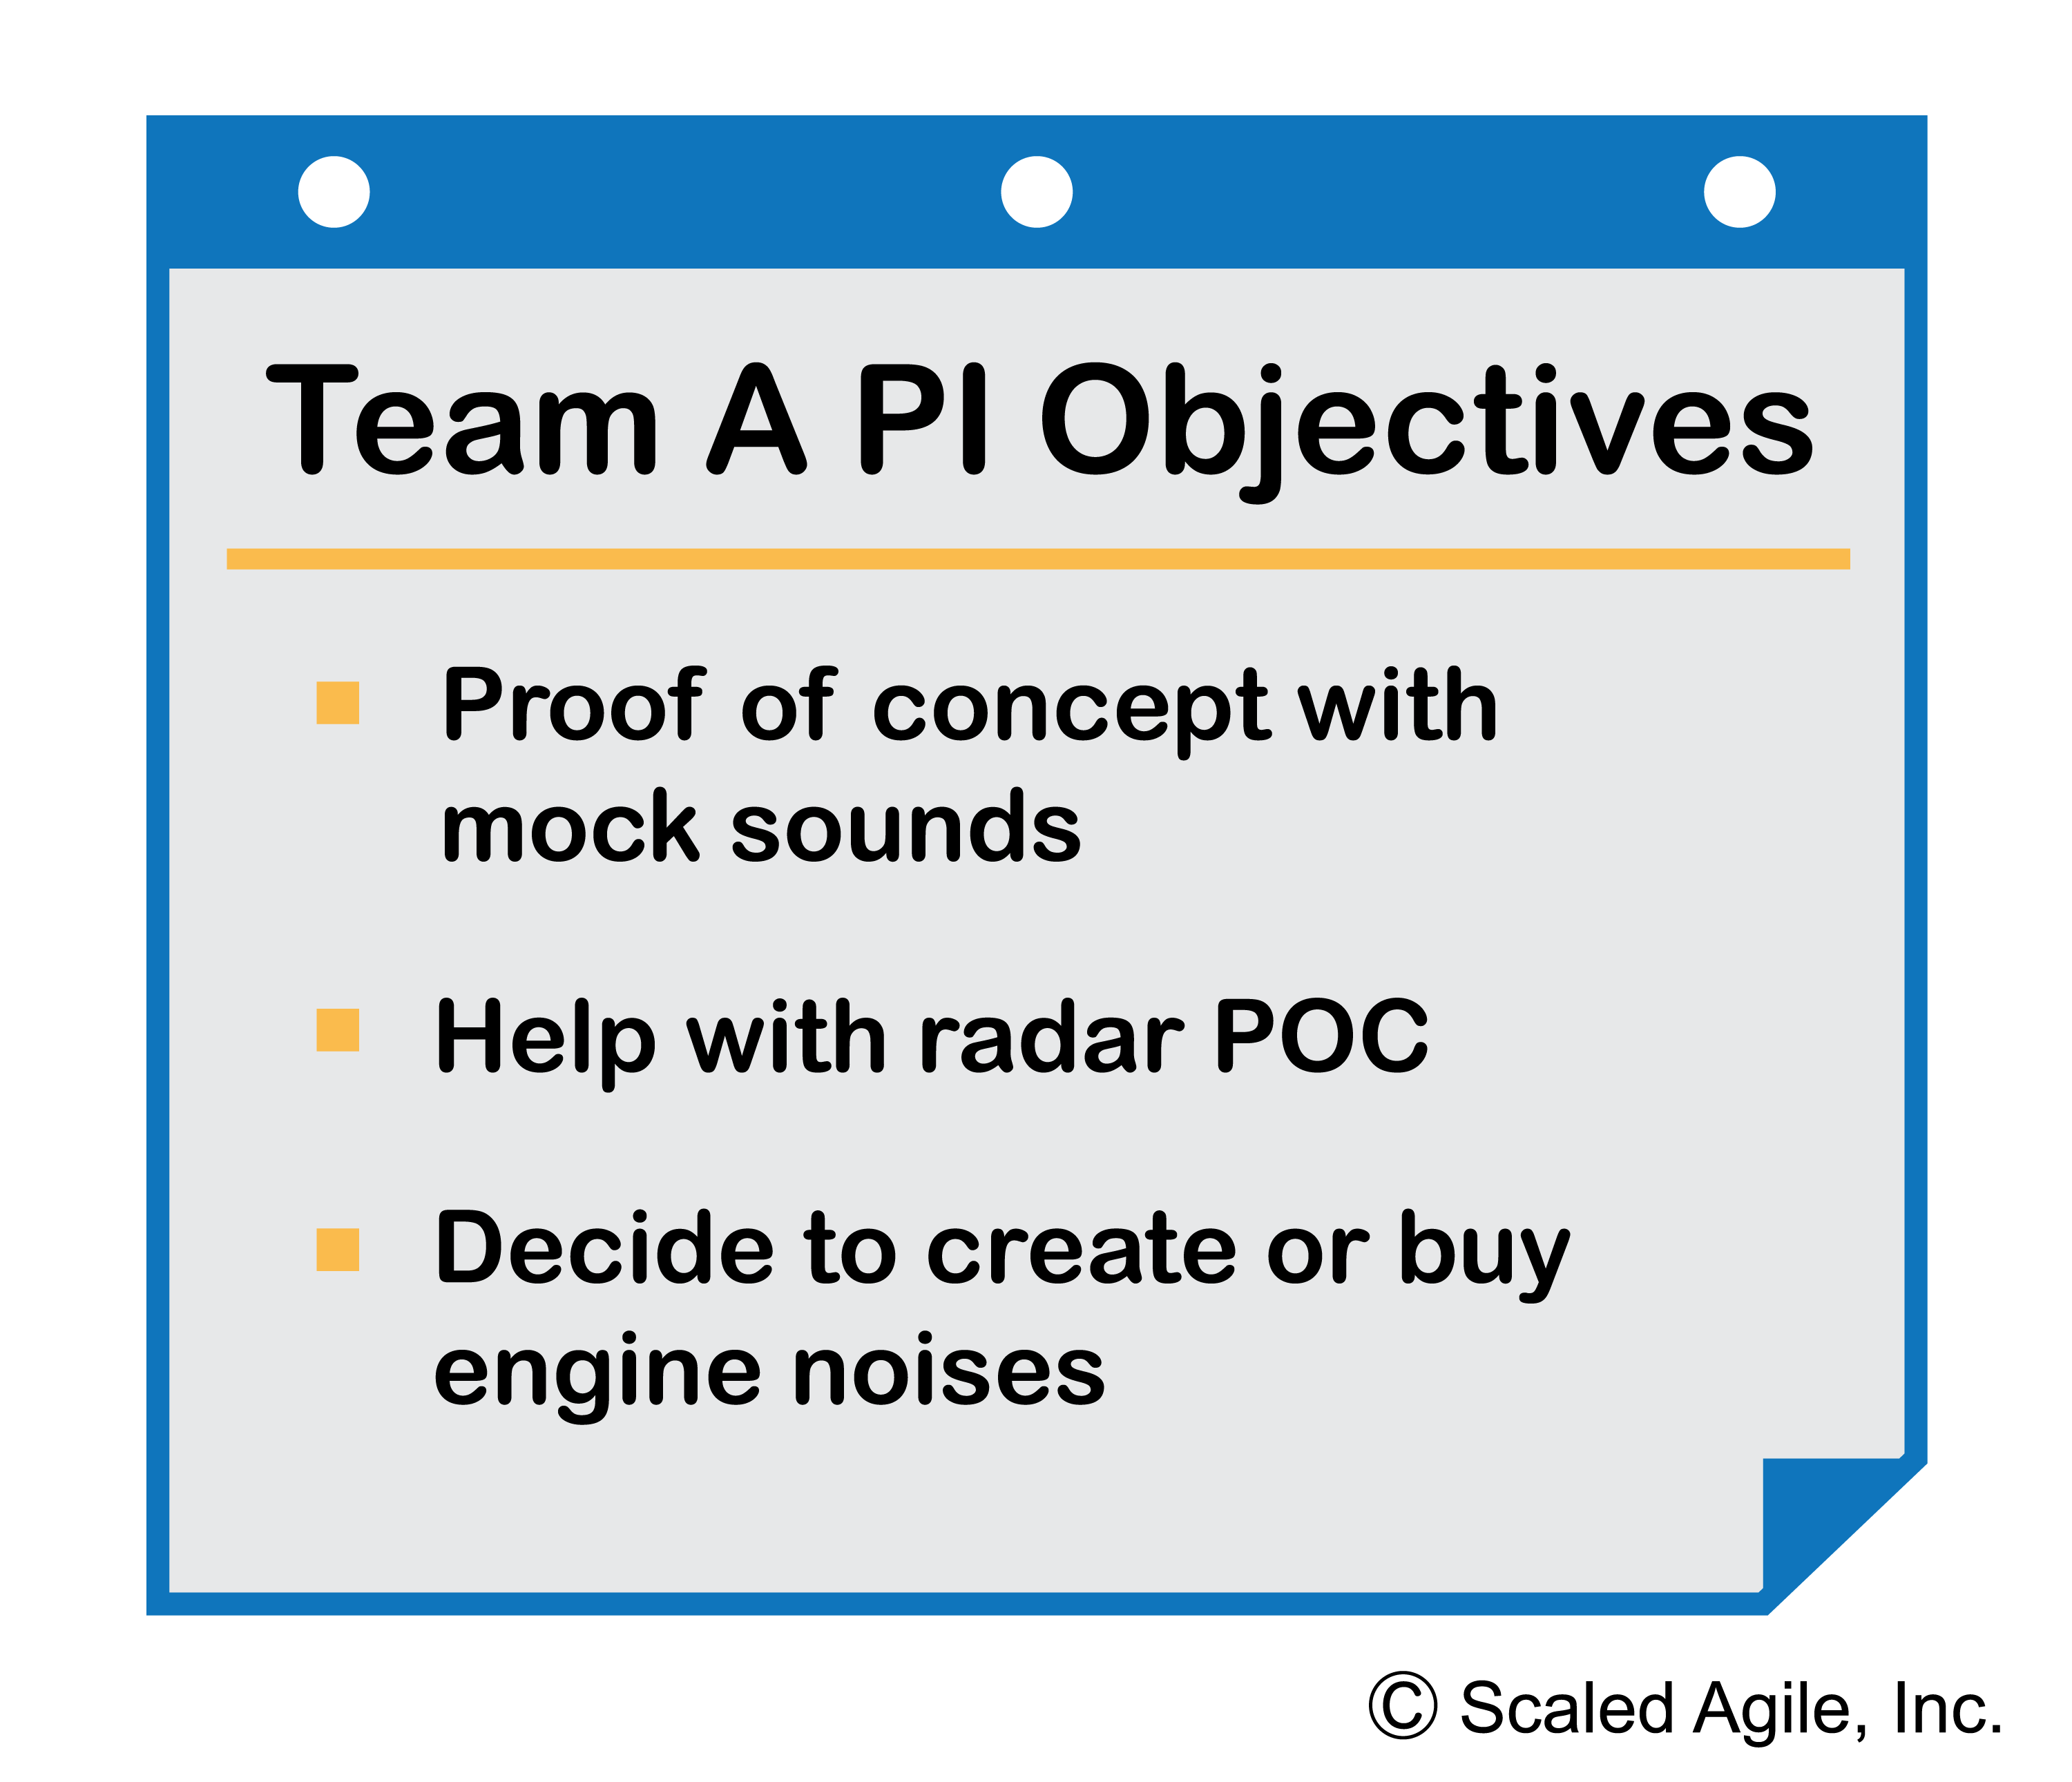
Uncommitted Objectives

Slide 38
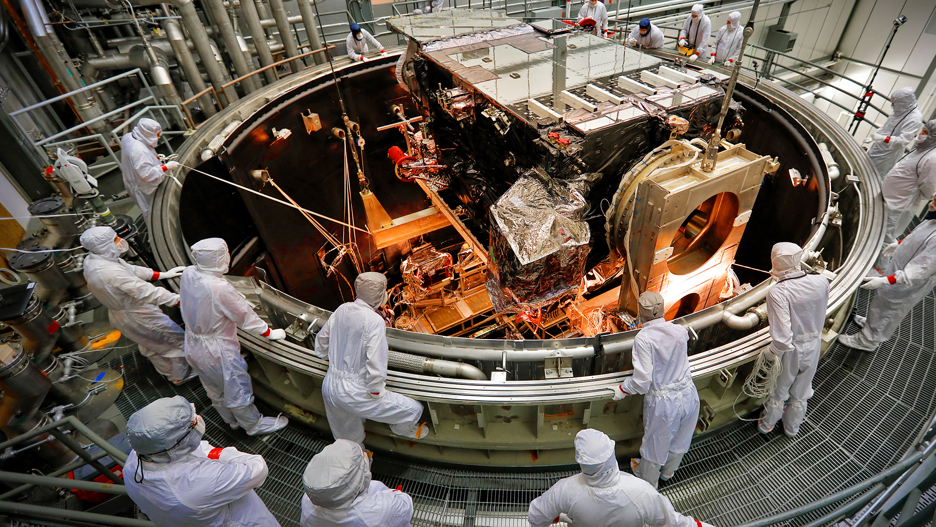
Why Enterprise Solution Delivery?
Humanity has always dreamed big; and scientists, engineers, and software developers then turn those big dreams into reality. That requires innovation, experimentation, and knowledge from diverse disciplines. Engineers and developers bring these innovations to life by defining and coordinating all the activities to successfully specify, design, test, deploy, operate, evolve, and decommission large, complex solutions.
Enterprise Solution Delivery
Courtesy NASA Goddard

Slide 39

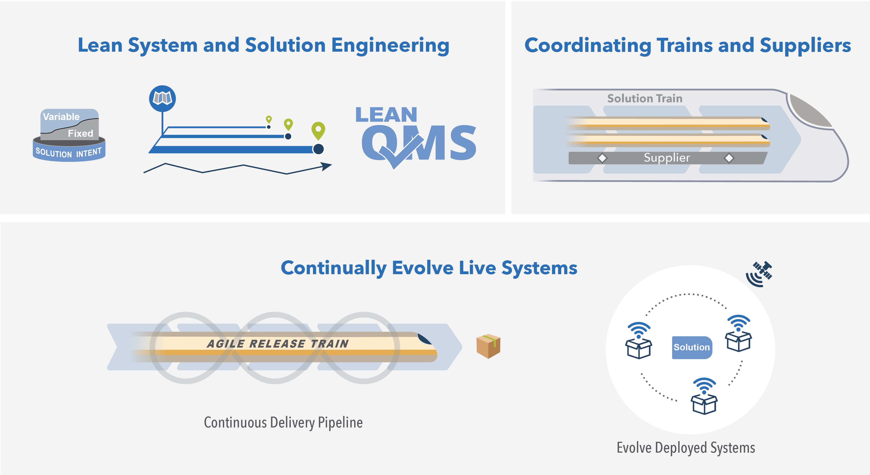
Enterprise Solution Delivery
Apply Lean system engineering to build really big systems
Coordinate and align the full supply chain
Continually evolve live systems.

Slide 40
Nine best practices for Enterprise Solution Delivery
1. Continually refine the fixed/variable Solution Intent
2. Apply multiple planning horizons
3. Architect for scale, modularity, releasability, and serviceability
4. Continually address compliance concerns
5. Build and integrate solution components and capabilities with Agile Release
Trains (ARTs) and Solution Trains
6. Apply ‘continuish’ integration
7. Manage the supply chain with systems of systems thinking
8. Build a Continuous Delivery Pipeline
9. Evolve deployed systems

Slide 41

Why Lean Portfolio Management?
Traditional approaches to portfolio management were not designed for a global economy or the impact of digital disruption. These factors put pressure on enterprises to work under a higher degree of uncertainty, and yet deliver innovative solutions much faster.

Slide 42

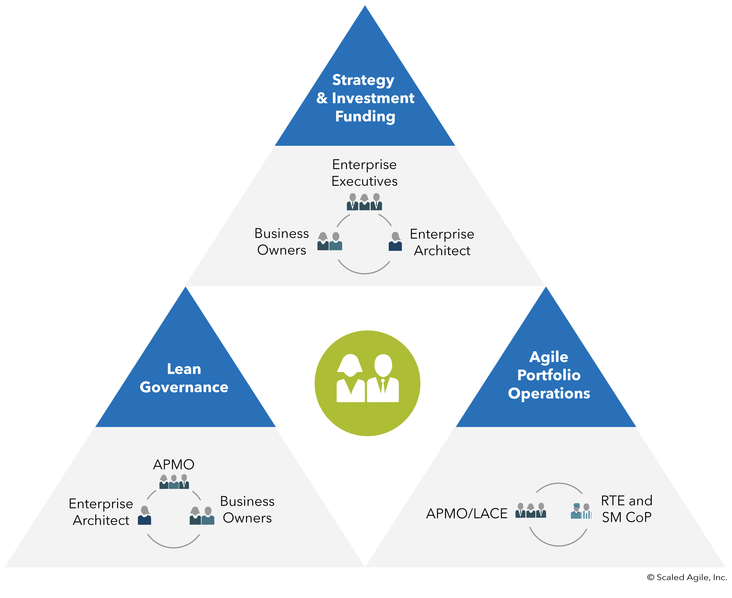
Lean Portfolio Management
Align strategy, funding, and execution
Optimize operations across the portfolio
Lightweight governance empowers decentralized decision-making

Slide 43
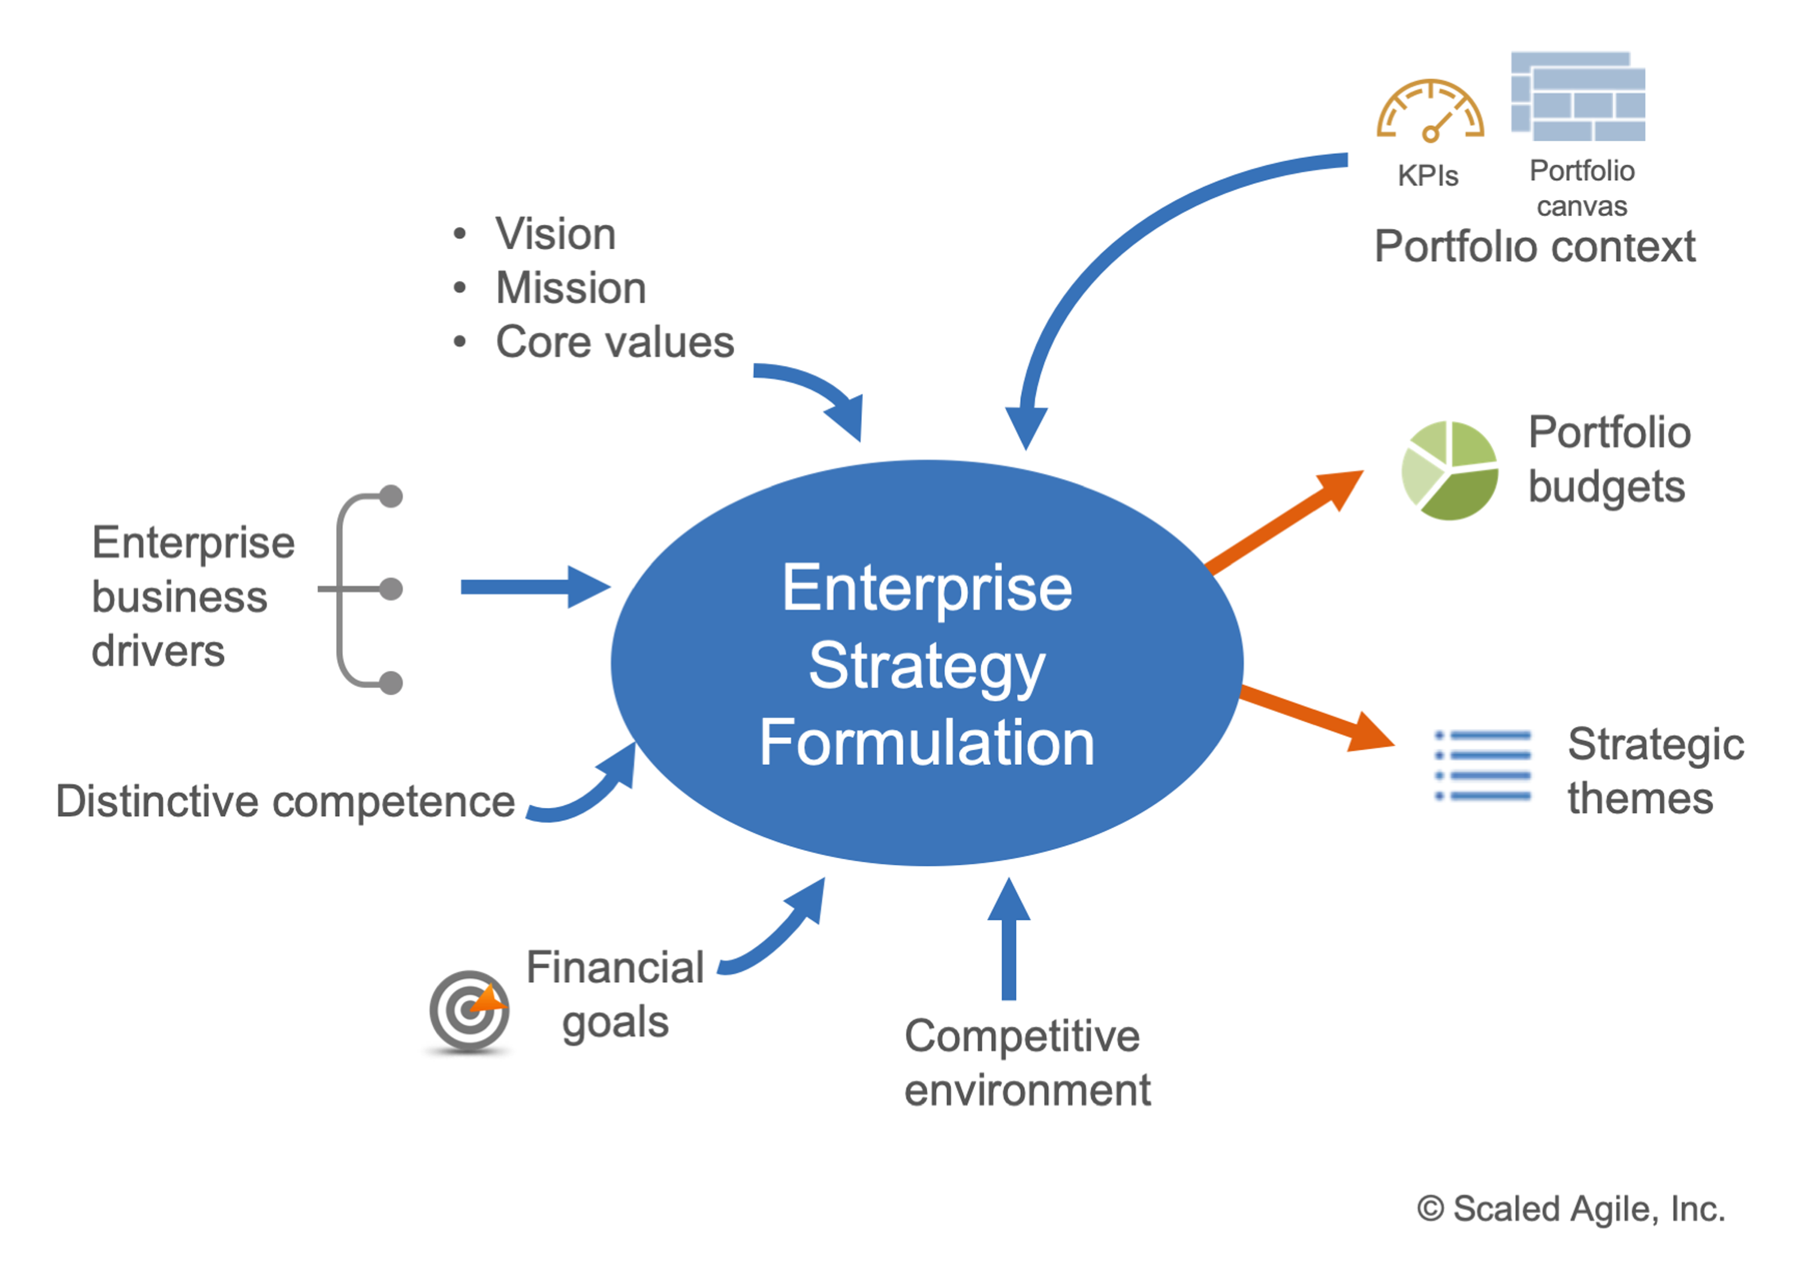
Revised enterprise strategy formulation guidance

Slide 44
Strategic Themes with OKRs
Objective | Key Results
Increase customer engagement in our community platform | Reduce membership churn from 20% to 5%
 | Increase Net Promoter Score from 35 to 60
 | Improve average weekly visits per active user from 5,000 to 20,000
 | Increase non-paid (organic) traffic to from 1,500 to 5,000
 | Improve engagement from 30% to 60%

Slide 45
Focus on the Portfolio Vision

Slide 46
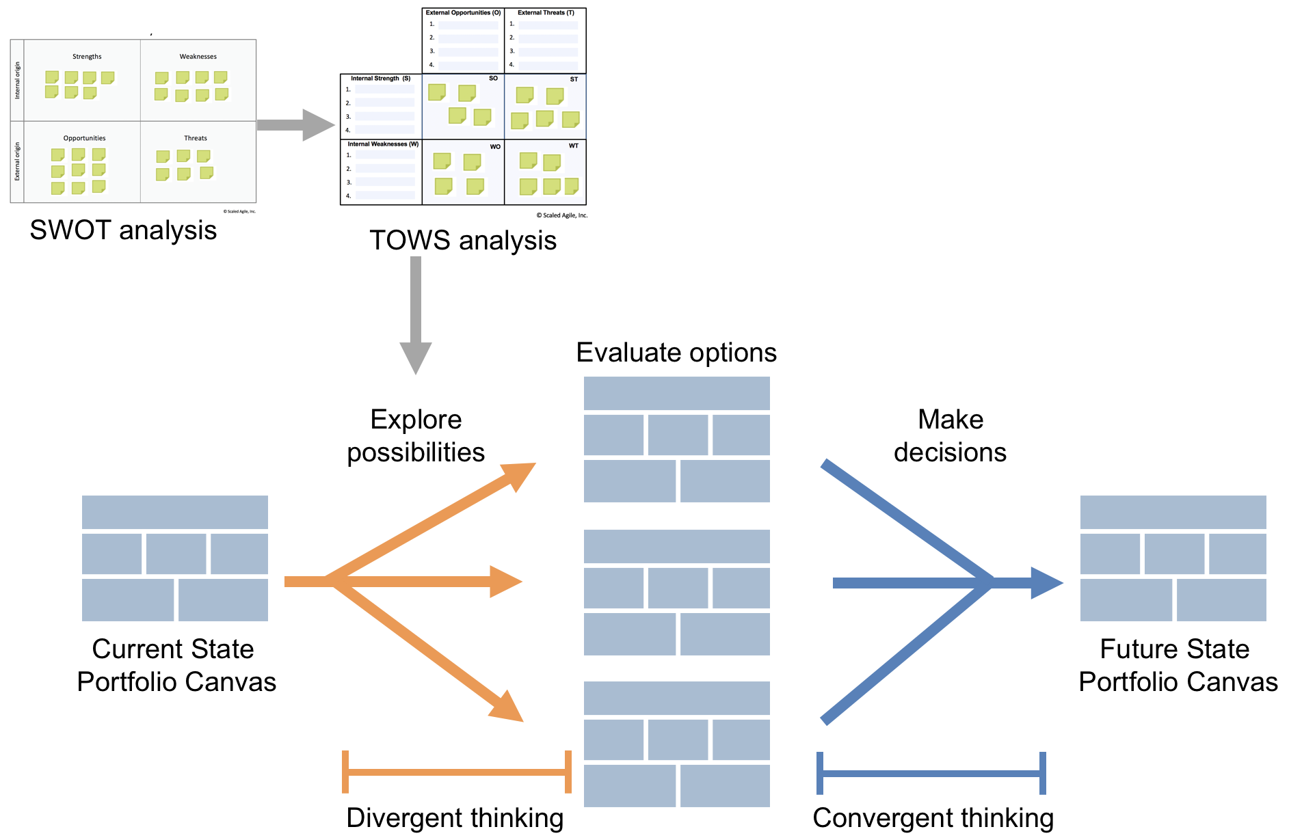
Portfolio Vision – added TOWS analysis

Slide 47
Enhanced SAFe Lean Startup Epic lifecycle

Slide 48
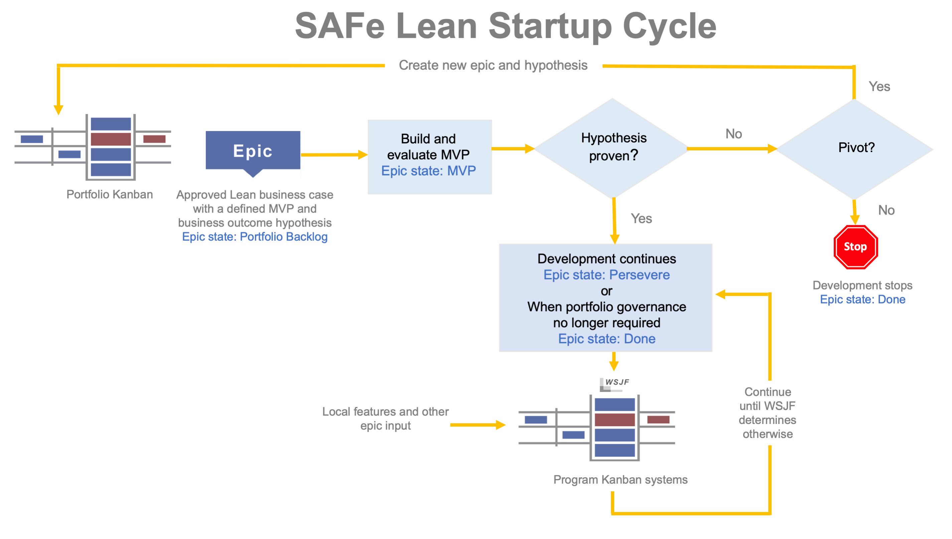
Enhanced SAFe Lean Startup Epic lifecycle

Slide 49

Why
Organizational Agility?
Without organizational agility, enterprises simply cannot respond sufficiently to the challenges and opportunities that today’s rapidly changing markets present. Without it, employees and the enterprise associate an individual’s value with their functional skills, rather than business outcomes.

Slide 50
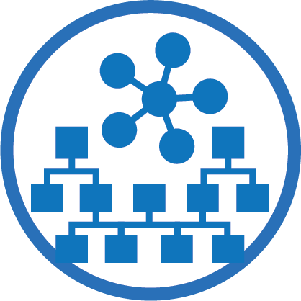
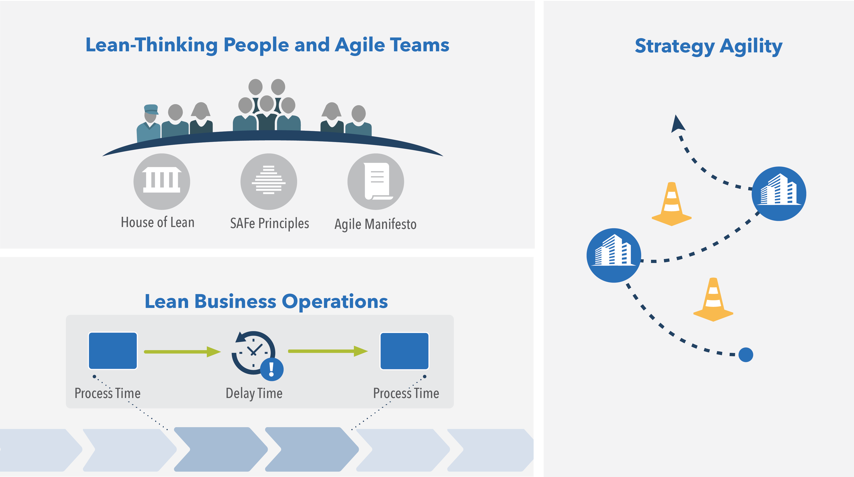
Organizational Agility
Create an enterprise-wide, Lean-Agile mindset
‘Lean out’ business operations
Respond quickly to opportunities and threats

Slide 51
Map operational value streams
Approve campaign
Create content
Approve content
Test system
Process time
1 day
2 days
4 hrs.
4 hrs.
Delay time
2 weeks
1 week
2 weeks
(Wait for people availability)
(Wait for approval authority)
(Wait for IT support)
14%
29 days
4 days
Total lead time time
Total processing time
Time efficiency

Slide 52
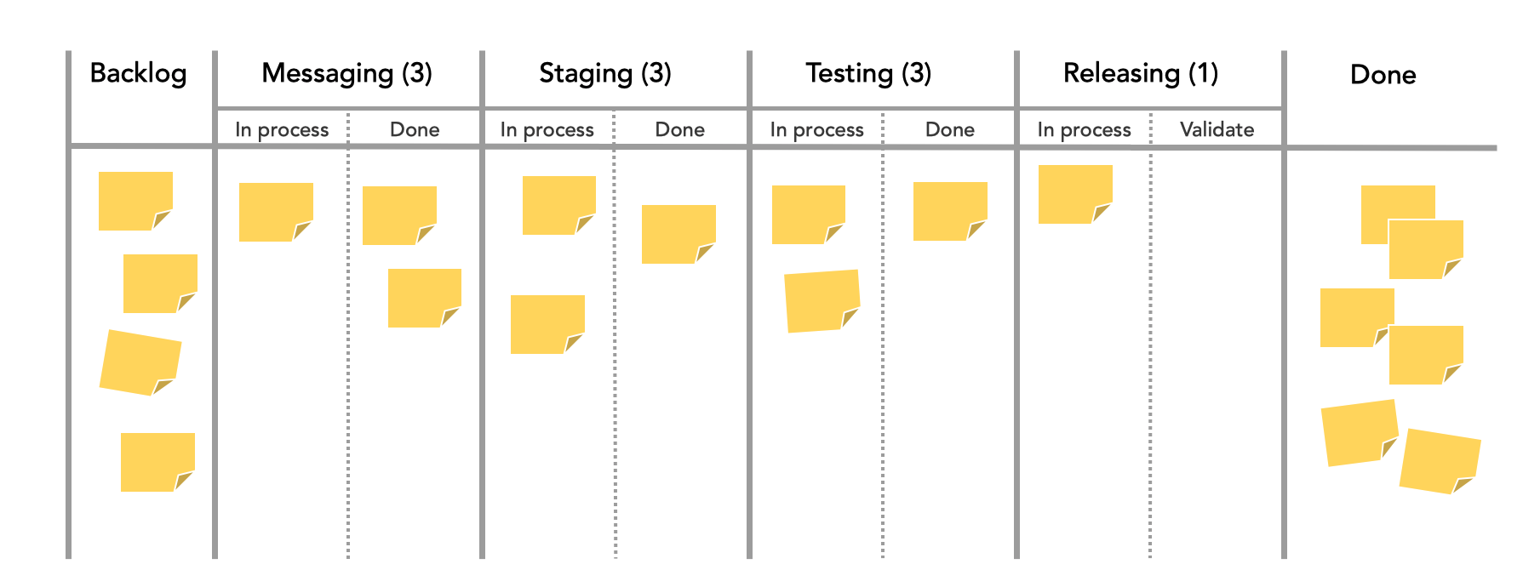
Visualize flow everywhere

Slide 53
Respond quickly to opportunities and threats
Continuous market sensing
Make strategy changes decisively
Organize and reorganize around value
Innovate like a startup
Implement changes quickly
And ignore sunk costs

Slide 54

Why Continuous Learning Culture?
In order to thrive in the current climate, organizations must evolve into adaptive engines of change, powered by a culture of fast and effective learning at all levels. Learning organizations leverage the collective knowledge, experience, and creativity of their workforce, customers, supply chain, and the broader ecosystem.

Slide 55

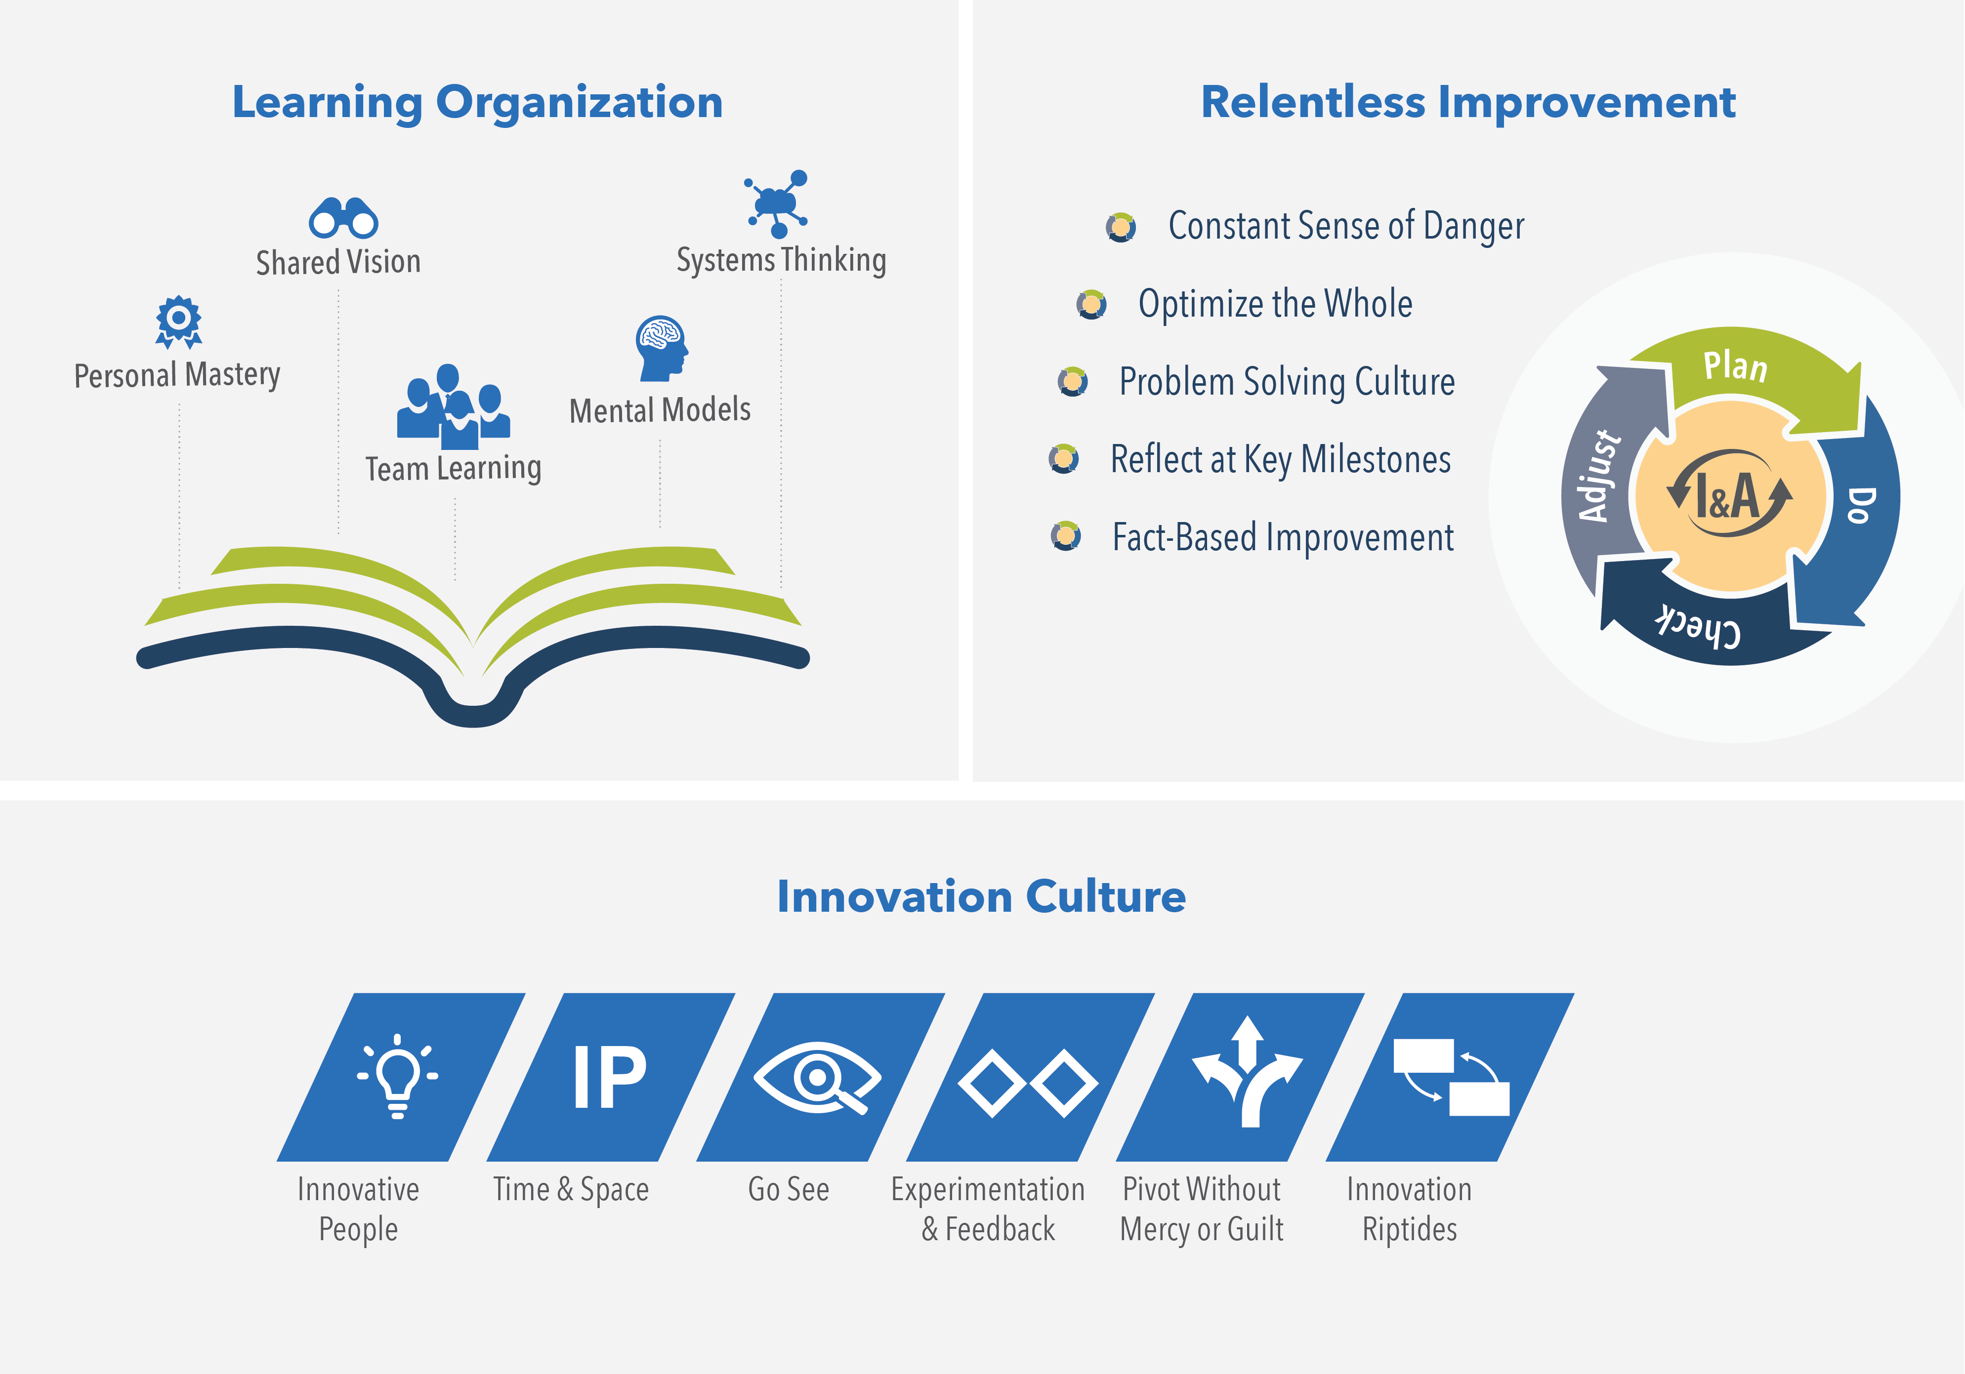
Continuous Learning Culture
Everyone in the organization learns and grows together
Exploration and creativity are part of the organization’s DNA
Continuously improving solutions, services, and processes is everyone’s responsibility

Slide 56
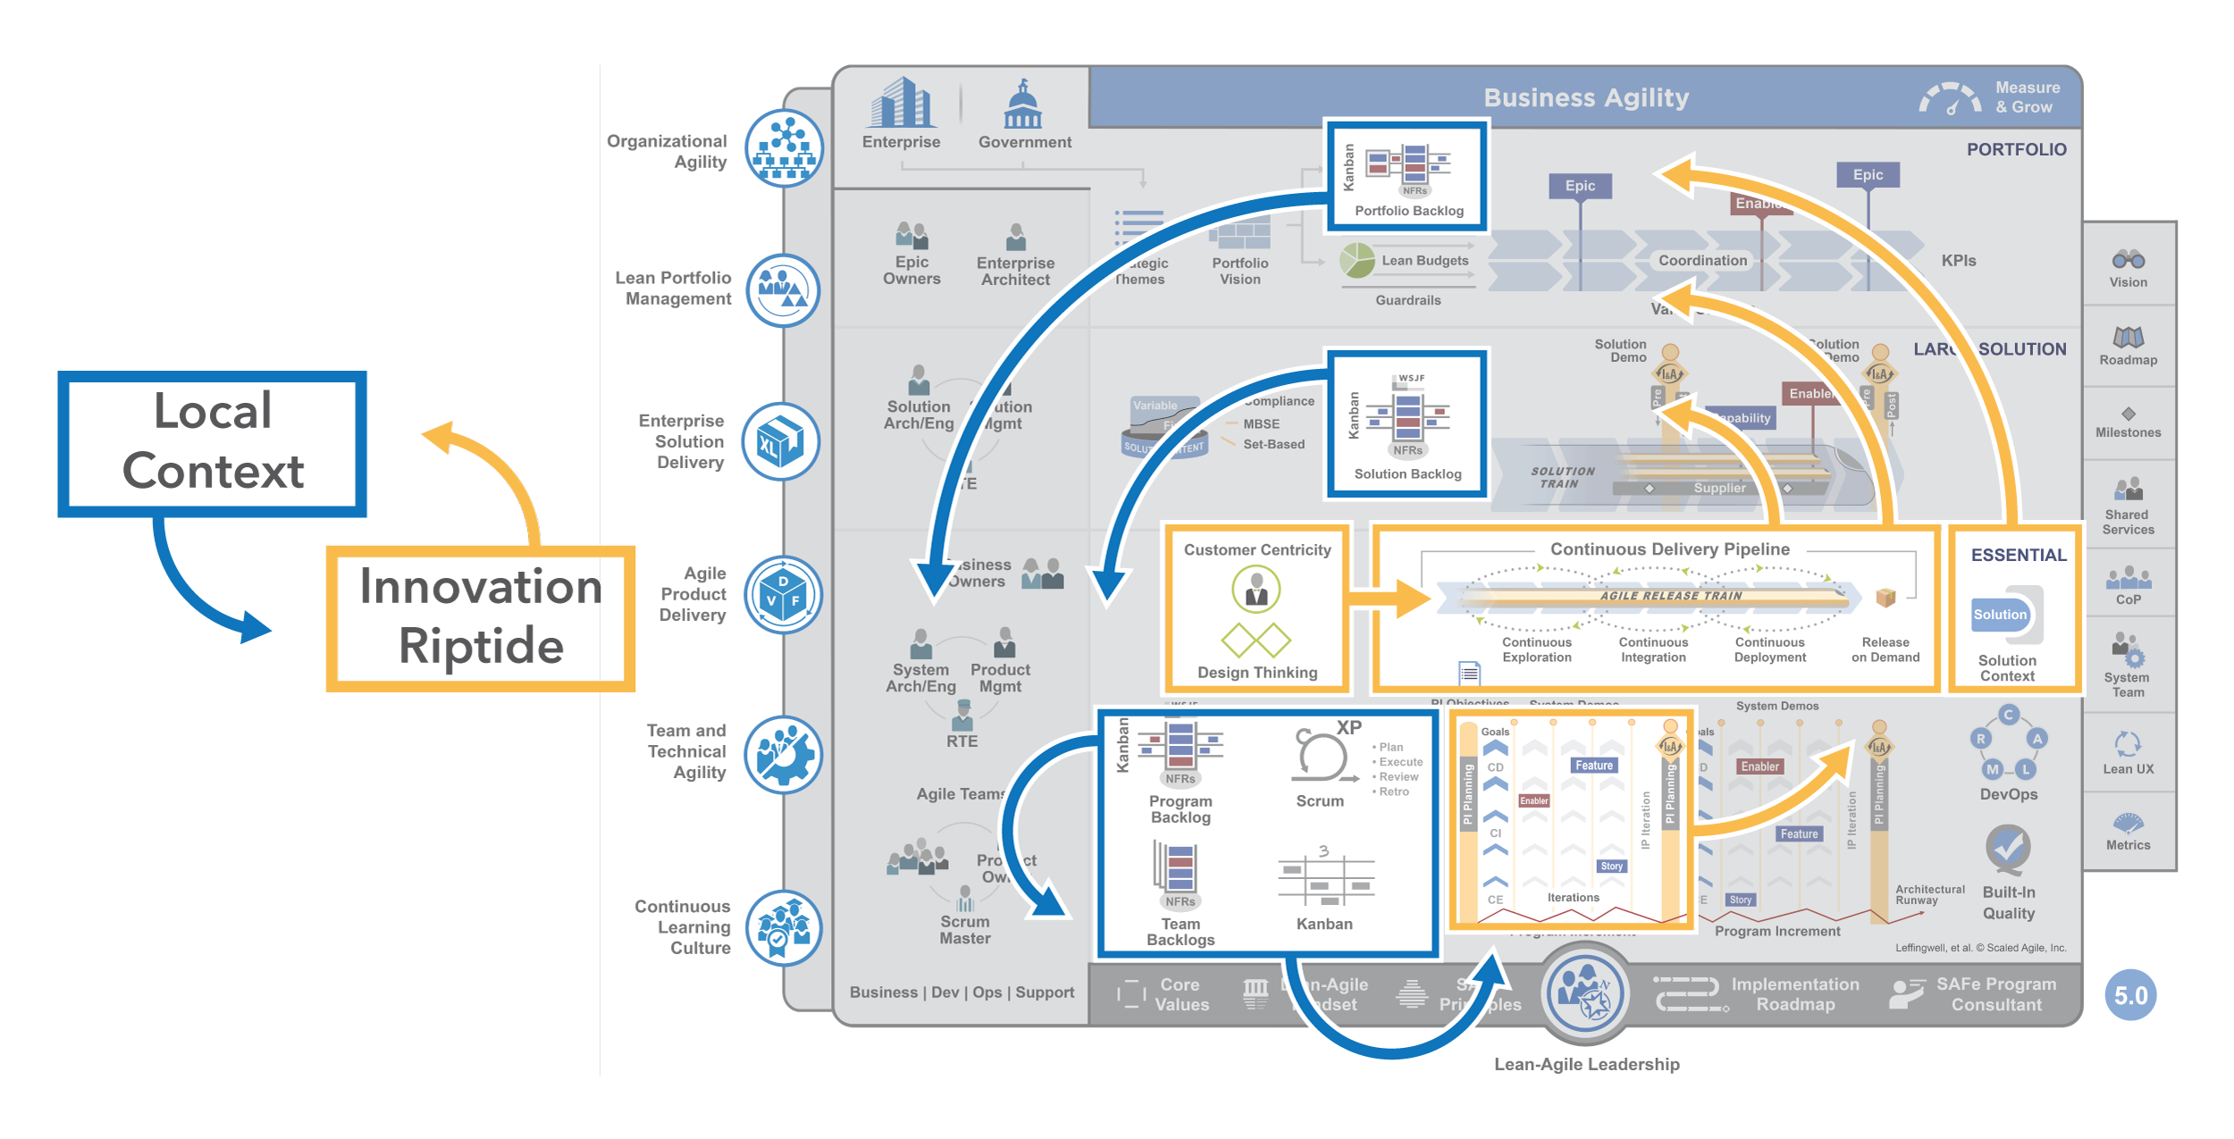
Exploit ‘innovation riptides’

Slide 57

Why Lean-Agile Leadership?
An organization’s managers, executives, and other leaders are responsible for the adoption, success, and ongoing improvement of Lean-Agile development and the competencies that lead to business agility. Only they have the authority to change and continuously improve the systems that govern how work is performed.

Slide 58

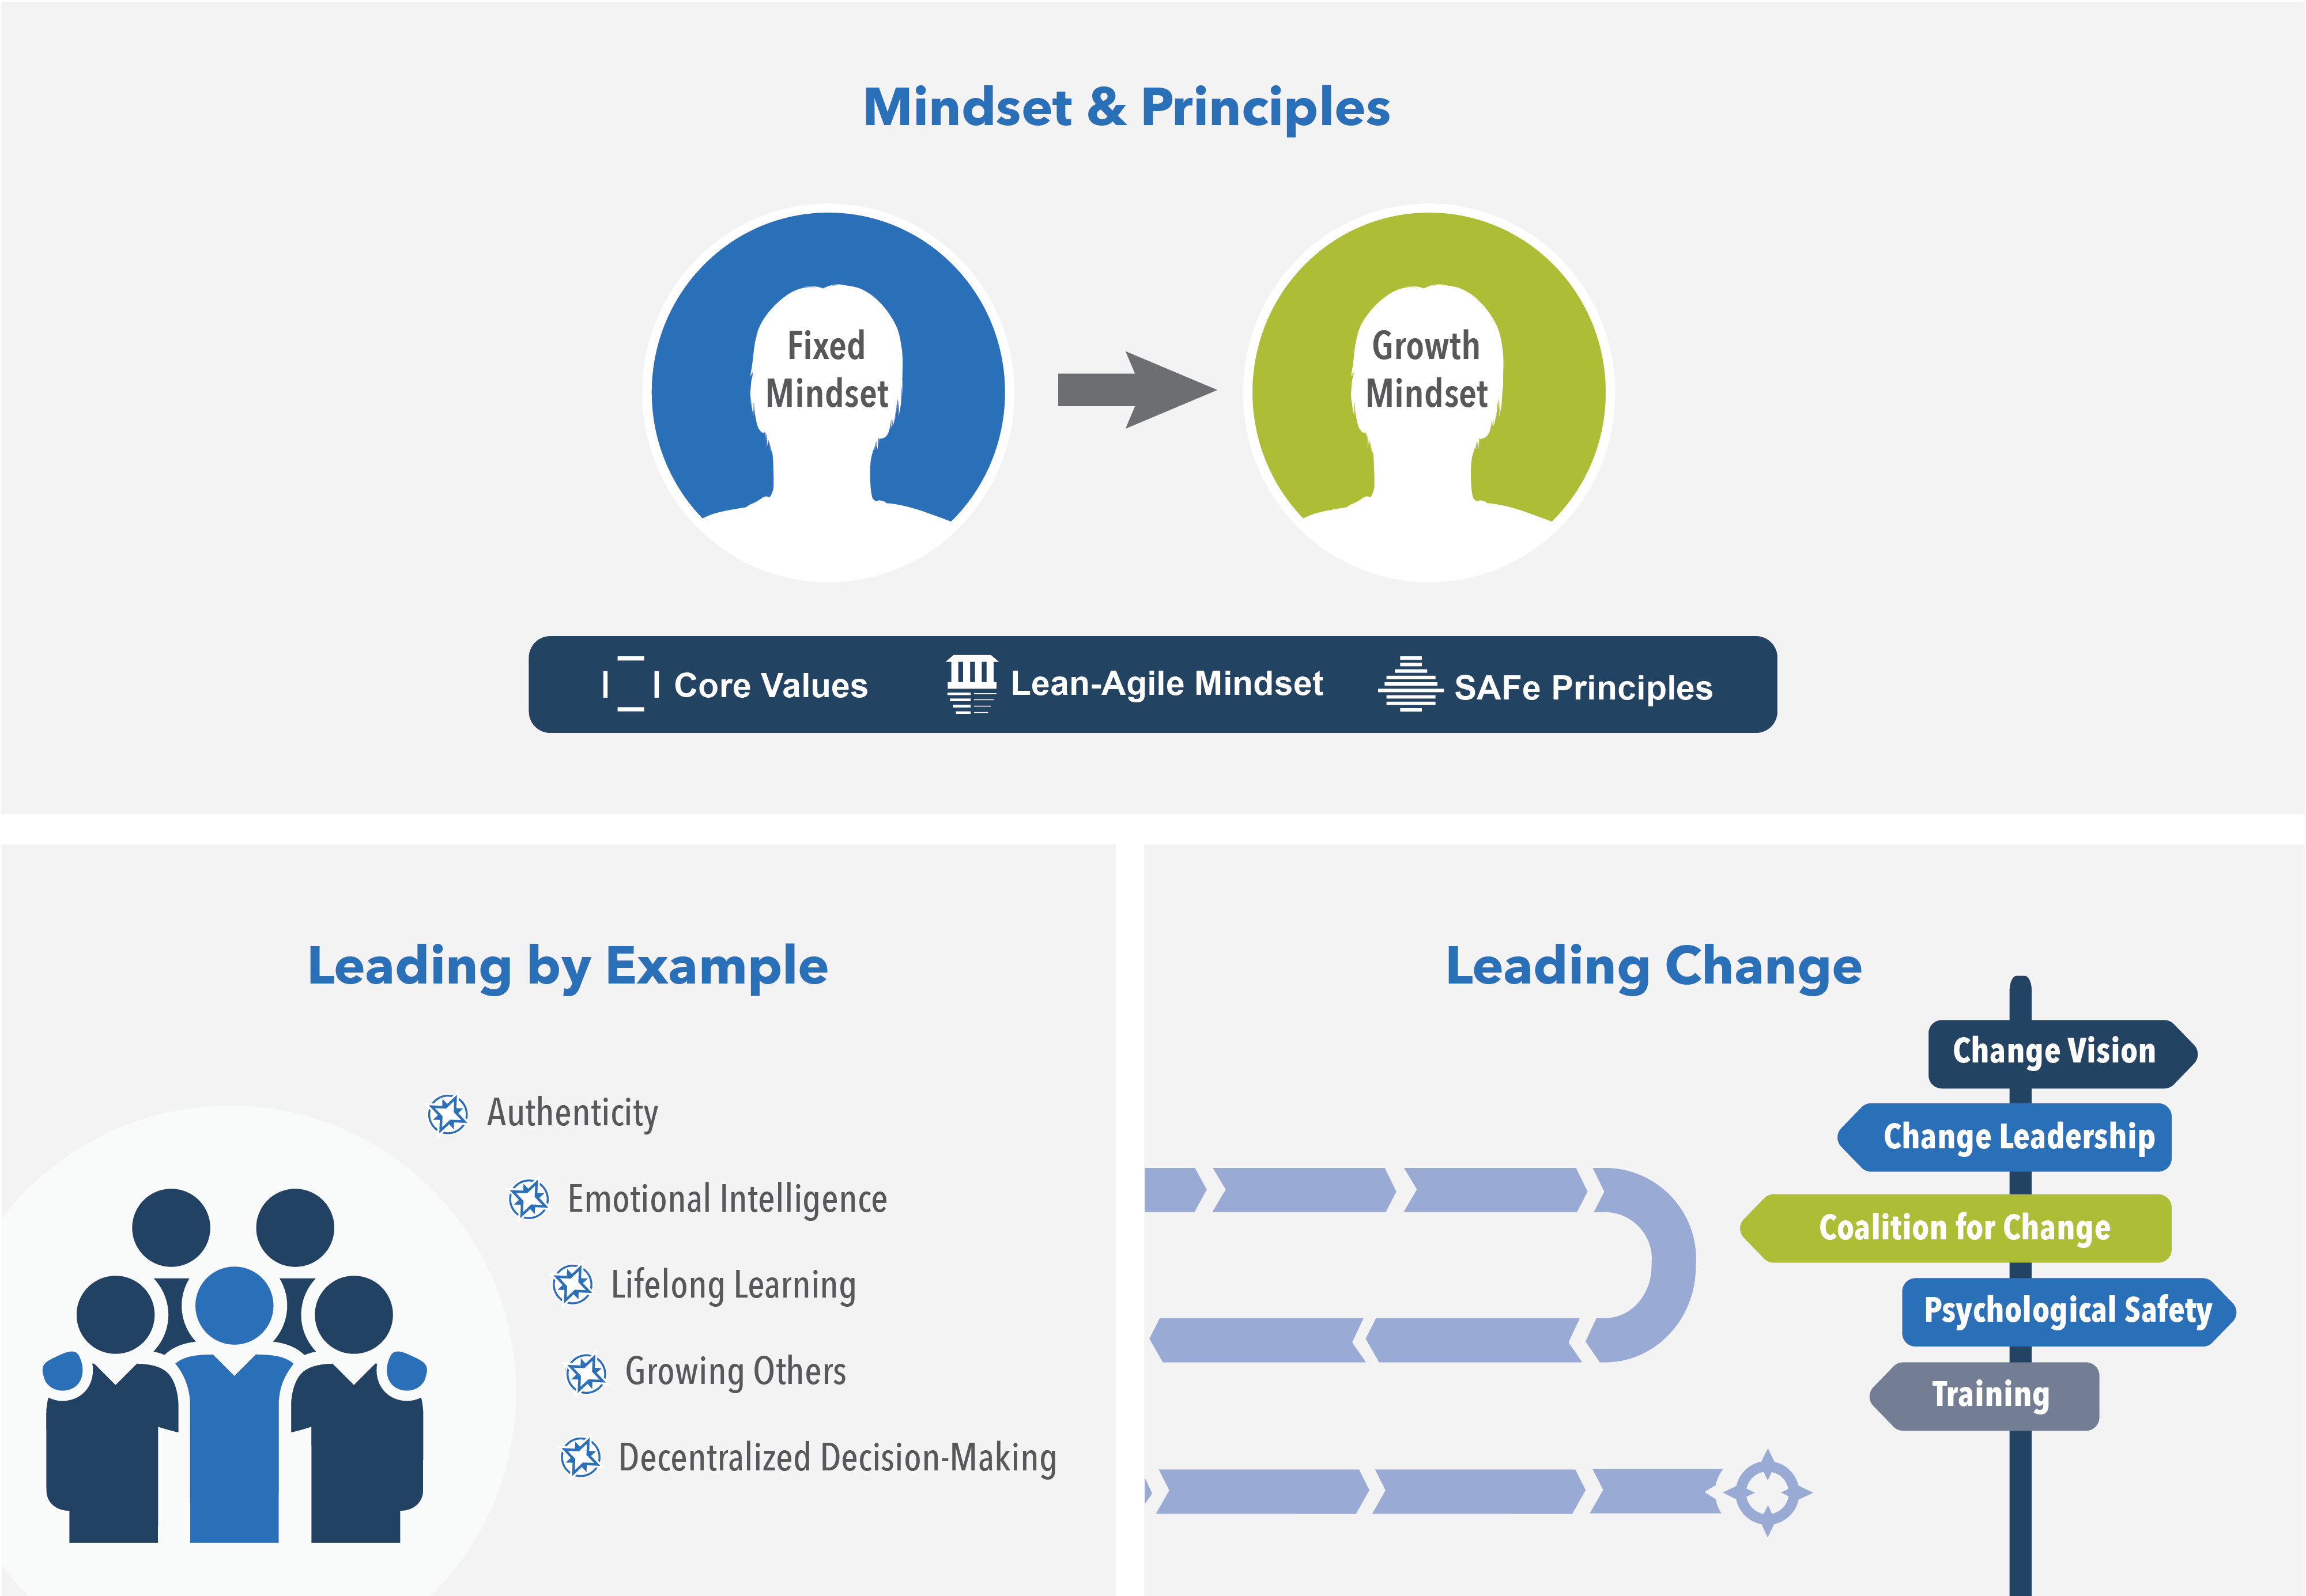
Lean-Agile Leadership
Inspire others by exhibiting desired behaviors
Align mindset, words, and actions to Lean-Agile values and principles
Actively lead the change and guide others to the new way of working

Slide 59
Mindsets CAN change
Learn to identify where you have a fixed mindset
Recognize that changing mindset is a choice
Take growth mindset actions that align to the new mindset.
“I like to try new things”
“I can either do it, or I can’t”
”I am inspired by the success of others”
”Failure is the limit of my abilities”
“My effort and attitude determine my abilities”
“I’m either good at it, or I’m not”
“Failure is an opportunity to grow”
“My abilities are unchanging”
GROWTH
MINDSET
FIXED
MINDSET
“I don’t like to be challenged”
“Challenges help me grow”
“My potential is predetermined”
”I can learn to do anything I want”
“When I’m frustrated, I give up”
“Feedback is constructive”
“I stick to what I know”

Slide 60
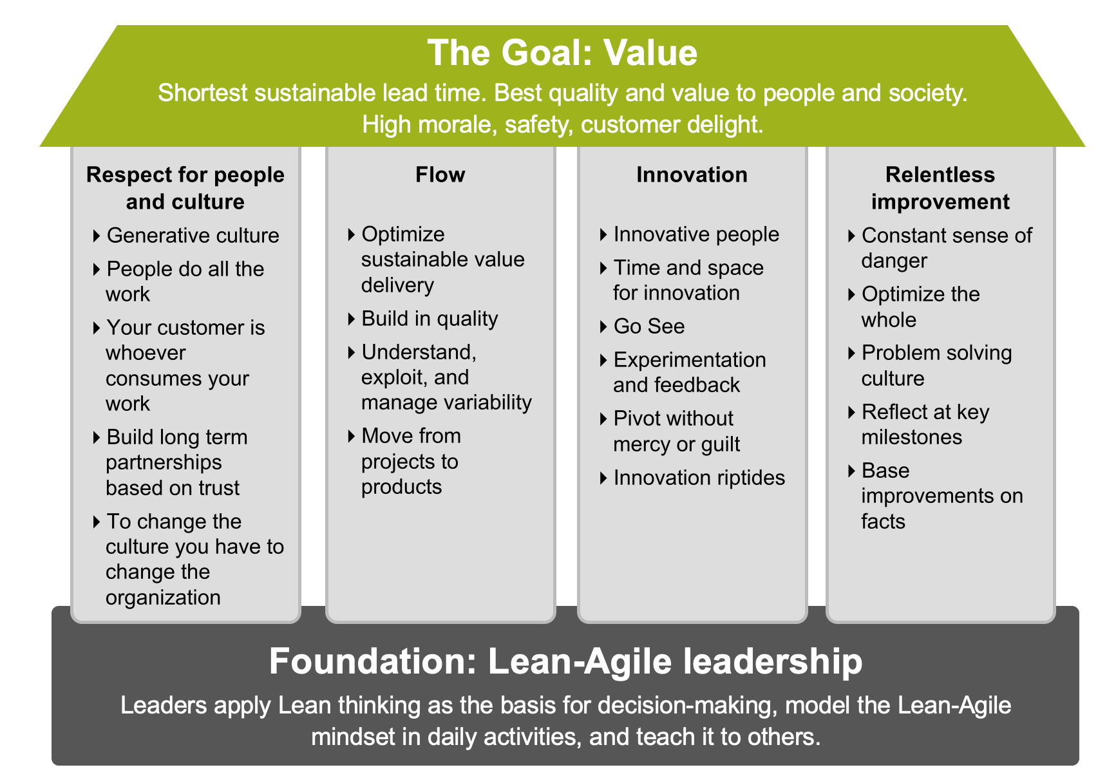
Enhanced SAFe House of Lean

Slide 61
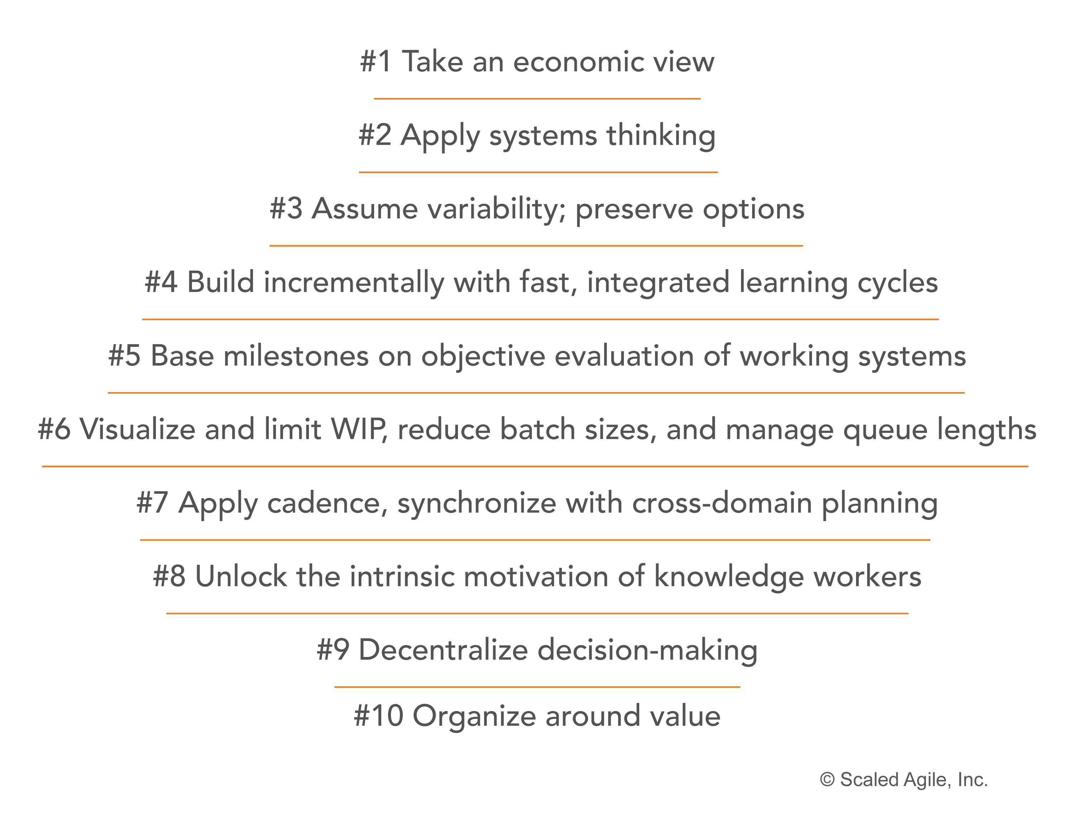
New 10th principle

Slide 62
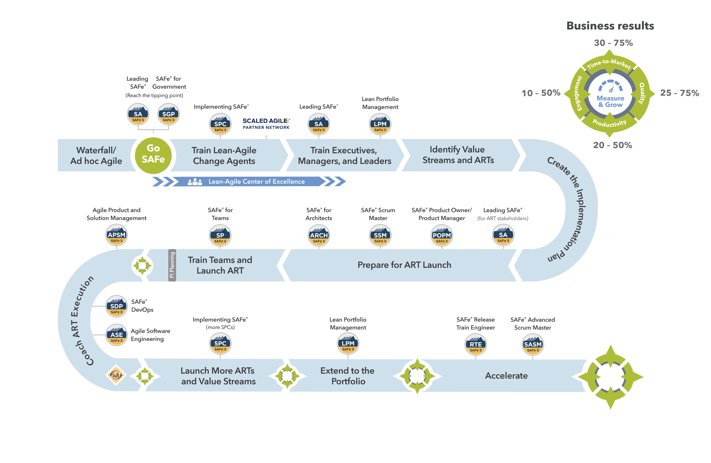
Enhanced Implementation Roadmap

Slide 63
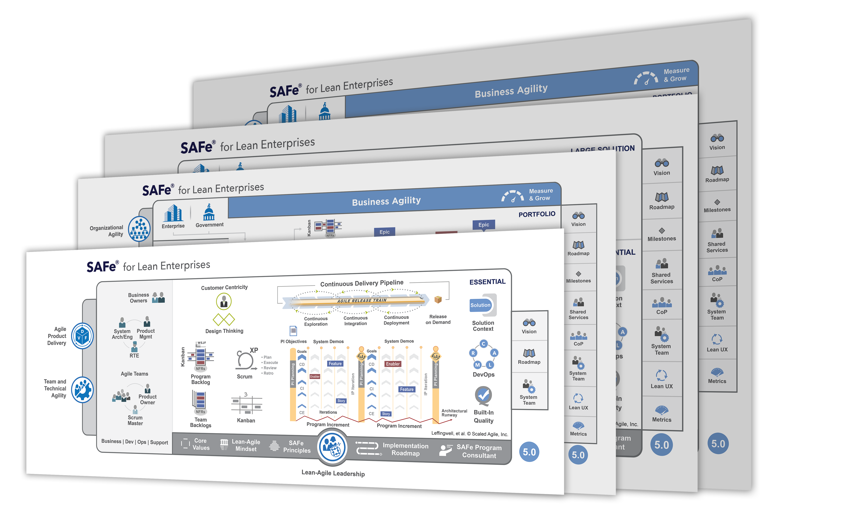
Configurations

Slide 64
Essential SAFe

Slide 65
The 10 critical ART success factors

Slide 66
Large Solution SAFe

Slide 67
Portfolio SAFe

Slide 68
Full SAFe

Slide 69
Measure and Grow

Slide 70
New measure and grow assessment and practices

Slide 71
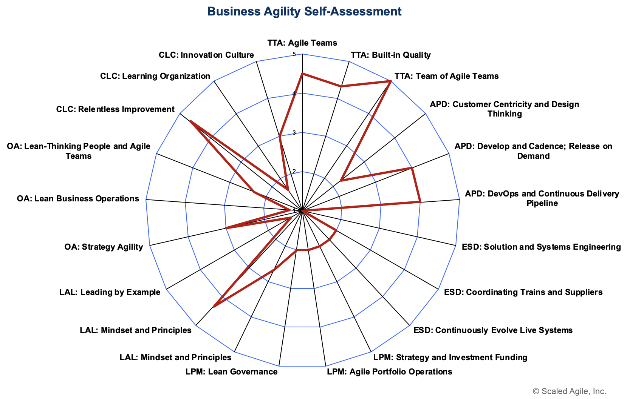
New Business Agility self-assessment
Measure and Grow is the way portfolios evaluate their progress towards business agility and determine their next improvement steps.
There are six steps in the measure and grow process:
Facilitate effective self-assessment of business agility
Analyze the results
Identify growth opportunities
Prioritize and take action
Integrate learning
Celebrate success

